Slide 1
FragPipe enables the one-stop analysis for DDA and DIA bottom-up proteomics
CNCP 2023
Aug 30, 2023
Fengchao Yu
University of Michigan, Ann Arbor, Michigan, United States

Slide 2
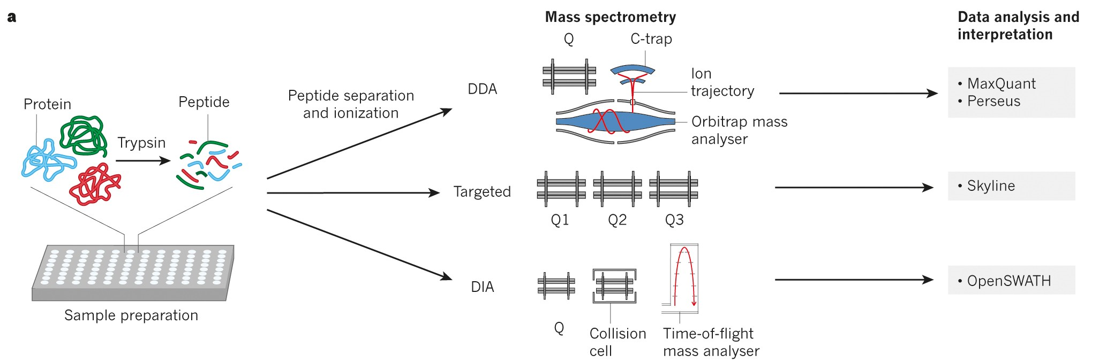
Data acquisition and analysis in bottom-up proteomics
Aebersold and Mann, Nature (2016)

Slide 3
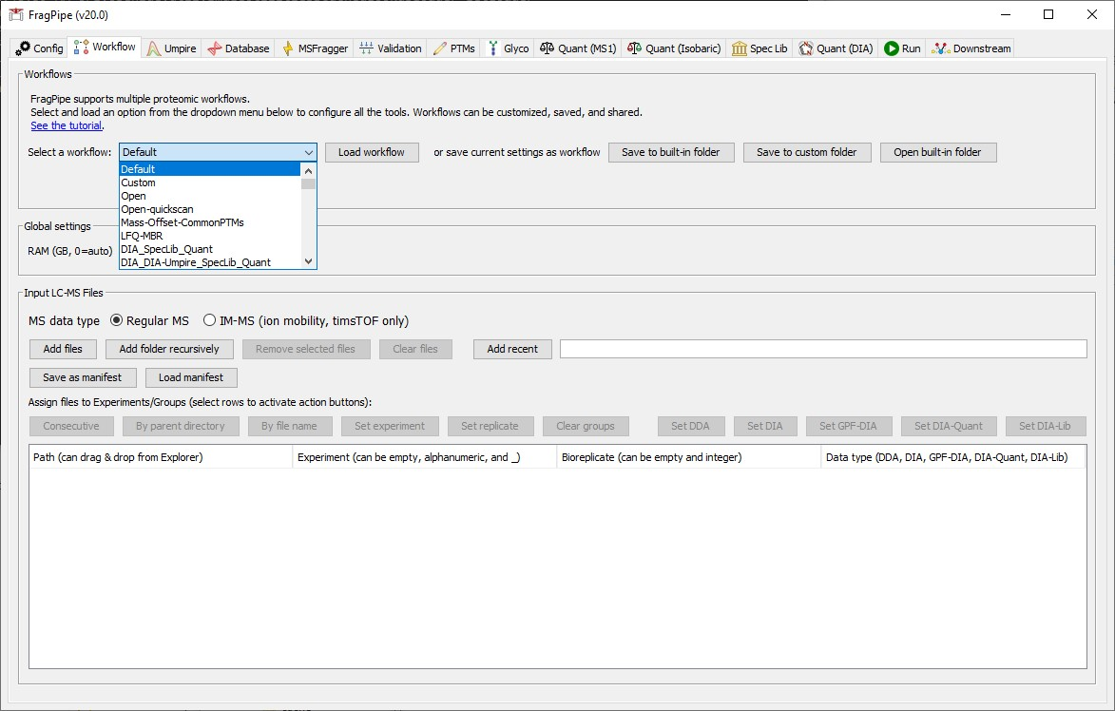
FragPipe is becoming one-stop proteomics data analysis suite
FragPipe supports:
Closed and open searches
FDR estimation
Glycopeptide search
Deep-learning-based rescoring
PTM discovery
Spectral library building
Label-free quantification
Isotopic-labeled quantification
Isobaric-labeled quantification
DIA peptide identification and quantification

Slide 4
Deep-learning-based prediction
How to use deep-learning-based prediction in peptide identification?
Generate a spectral library from the whole database
  The spectral library can be reused
  Predicting the whole database is slow
    PTMs and non-specific digestion make it too slow to be used in practice
Rescore the PSMs after database searching
  Most tools require GPU
  Most tools require Python or upload to webserver.
  There is no easy-to-use GUI interface

Slide 5
An ideal rescoring software
Most users do not have powerful NVIDIA GPUs
  CPU only
  Fast
Installing Python packages is not always easy
  No additional installation
  Plug and play (distributed with FragPipe)
Command line interface is not user friendly
  Easy-to-use GUI (FragPipe)

Slide 6
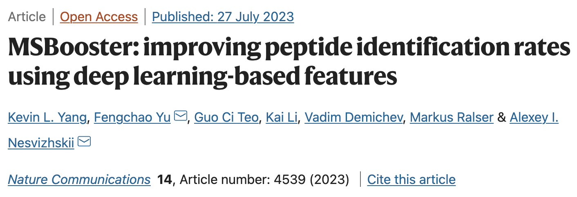
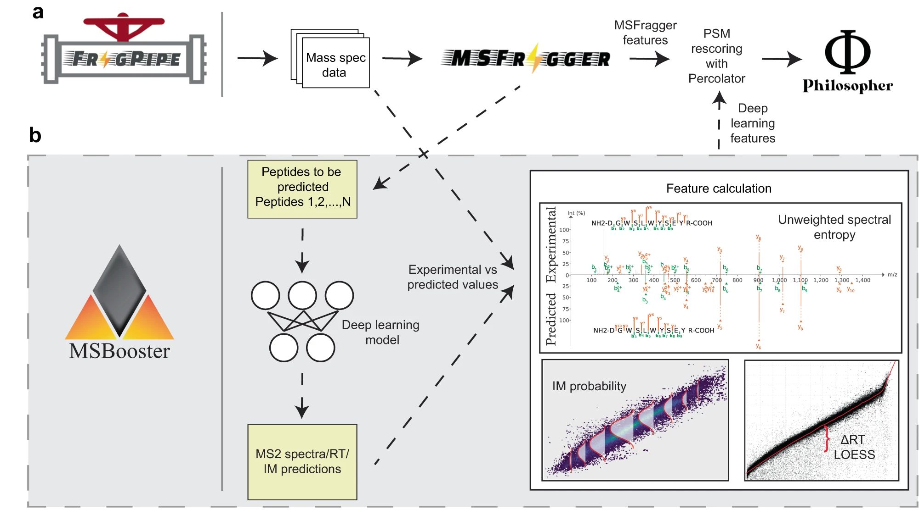
MSBooster

Slide 7
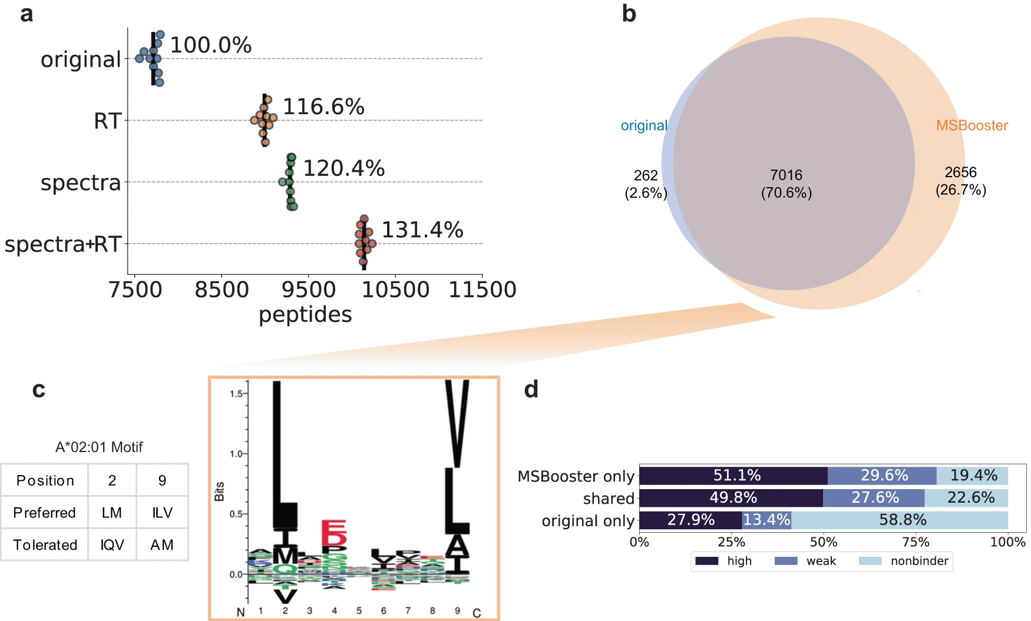
HLA rescoring
Yang et al., Nat. Commun. (2023)

Slide 8
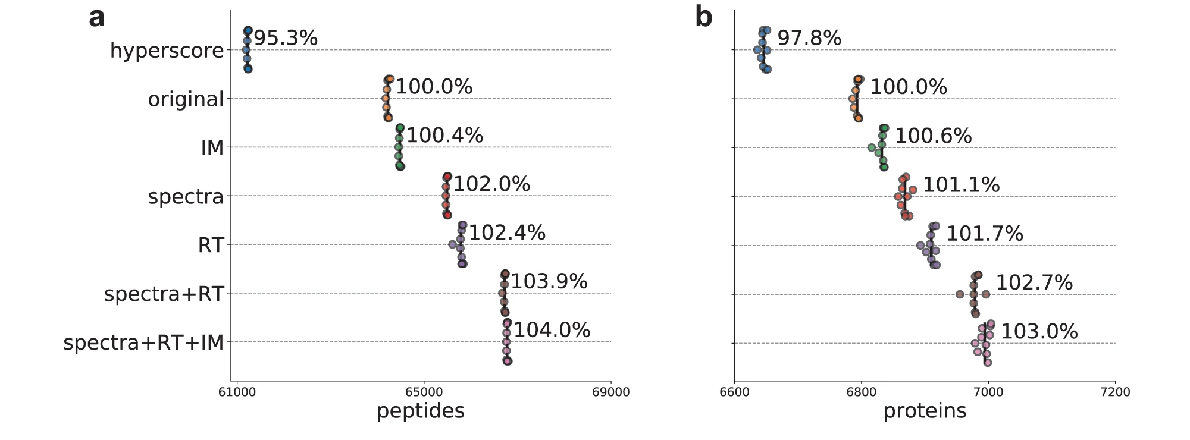
timsTOF HeLa tryptic search rescoring
Yang et al., Nat. Commun. (2023)

Slide 9
DIA data analysis
In silico/experimental spectral library based
  Easy to implement
  Easy to get good results from tryptic proteome data with common PTMs
  Many tools have been developed
  Time consuming
  Developing another tool is BORING
Feature extraction and pseudo-MS/MS based
  Sensitivity is low
  Slow

Slide 10
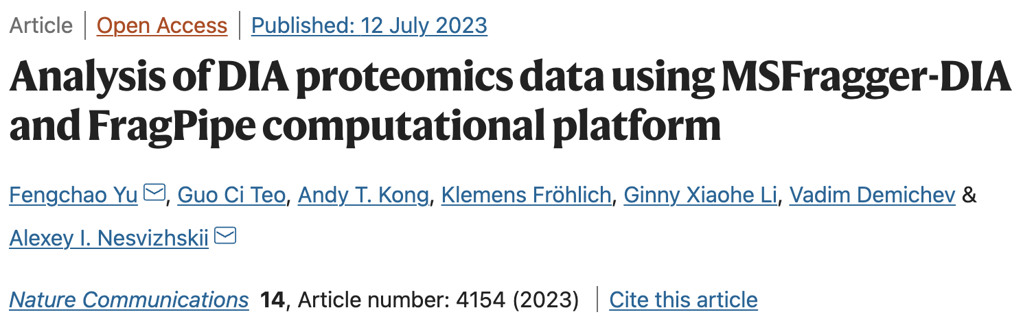
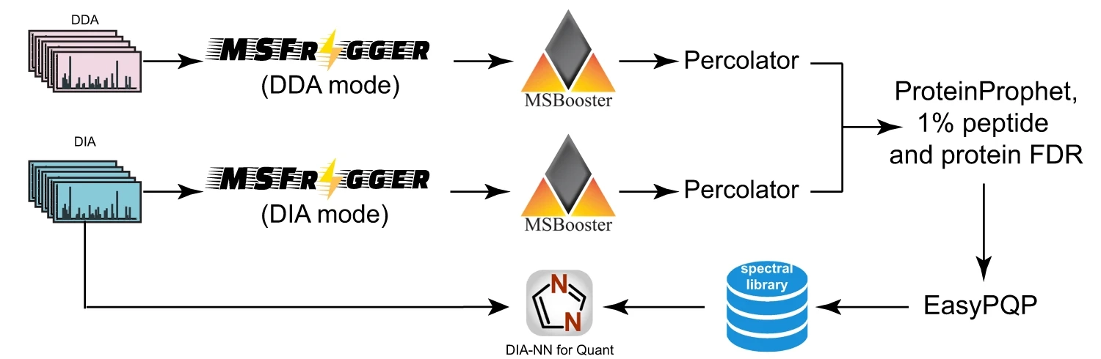
DIA data analysis

Slide 11
DIA data analysis
92 Human lymph nodes (real patient heterogeneity) + spike-in E. coli peptides
Data type | Condition name | #Samples | Mixture | E. coli to Human ratio
Single-shot DIA | Lymphnode | 23 | Human lymph node only | NA
 | 1-06 | 23 | Human lymph node + E. coli | 1/06 vs 1
 | 1-12 | 23 | Human lymph node + E. coli | 1/12 vs 1
 | 1-25 | 23 | Human lymph node + E. coli | 1/25 vs 1
GPF-DIA | Pooled samples, 6 fractions
DDA | Pooled samples, high-pH perfectionated, 2 × 10 fractions
Fröhlich et al., Nat. Commun. (2022)
Fröhlich et al., Nat. Commun., (2022)
Result label | Tools | Data | Approach
Spectronaut 14 | Spectronaut 14 | Single-shot DIA | directDIA
Spectronaut 17 | Spectronaut 17 | Single-shot DIA | directDIA+
DIA-NN lib-free | DIA-NN 1.8.1 |  | Library free (in-silico library prediction)
FP-MSF | FragPipe 18.0 + MSFragger 3.5 |  | Library free
FP-MSF hybrid |  | Single-shot DIA + GPF DIA + DDA

Slide 12
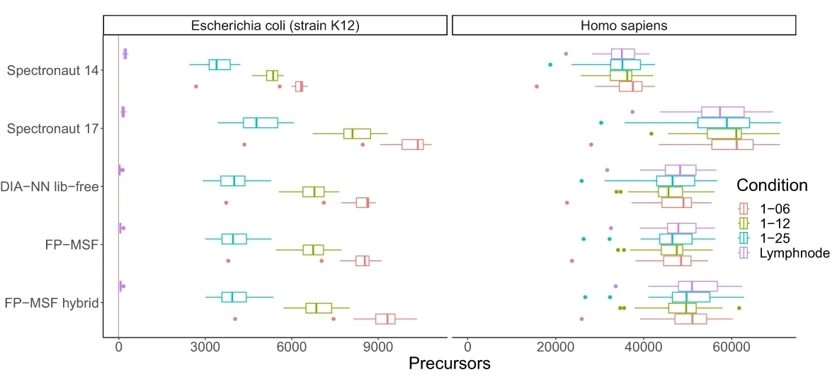
DIA data analysis
Tool | E.coli precursors | H. Sapiens precursors | ratio (%)
Spectronaut 14 | 1497 | 48390 | 3.094
Spectronaut 17 | 1337 | 86720 | 1.542
DIA-NN lib-free | 267 | 64846 | 0.412
FP-MSF | 414 | 68883 | 0.601
FP-MSF hybrid | 459 | 82155 | 0.559
Yu et al., Nat. Commun. (2023)

Slide 13
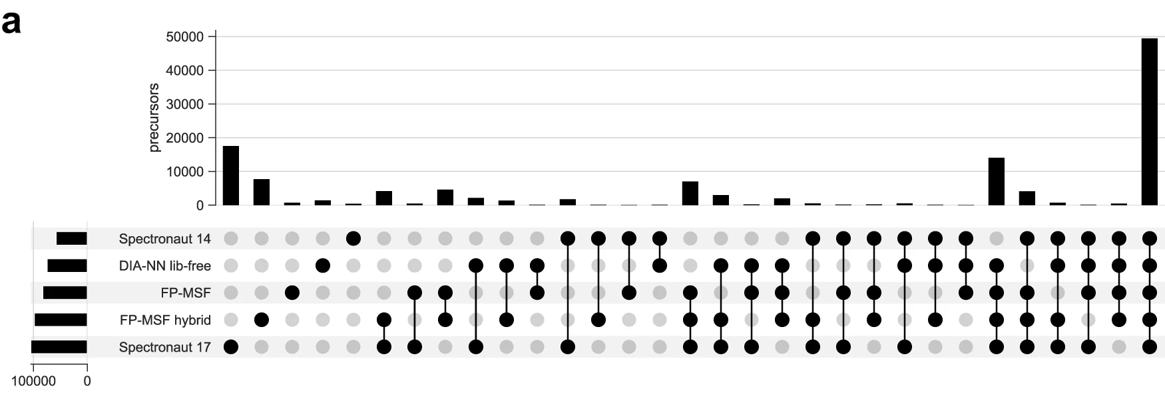
DIA data analysis
Yu et al., Nat. Commun. (2023)

Slide 14
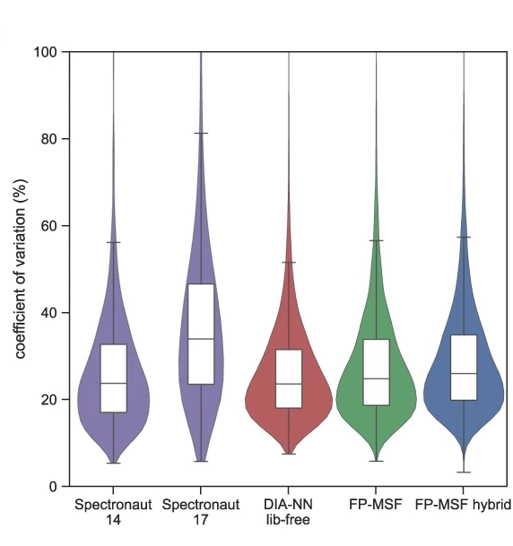
DIA data analysis
Condition name | #Samples | Mixture | E. coli to Human ratio
Lymphnode | 23 | Human | NA
1-06 | 23 | Human + E. coli | 1/06 vs 1
1-12 | 23 | Human + E. coli | 1/12 vs 1
1-25 | 23 | Human + E. coli | 1/25 vs 1
Yu et al., Nat. Commun. (2023)

Slide 15
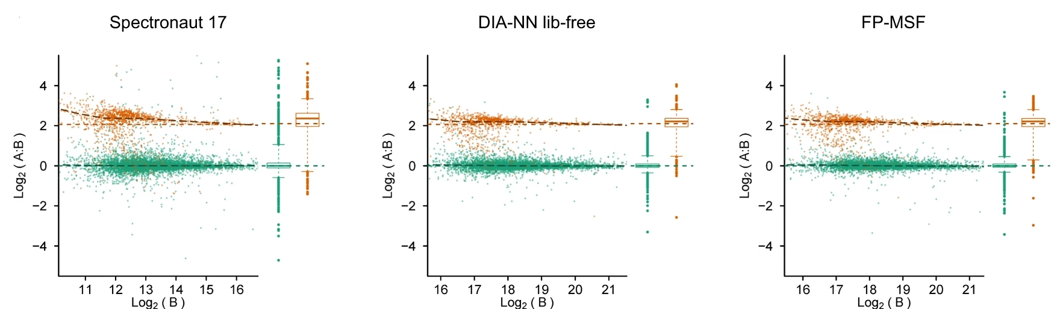
DIA data analysis
Condition name | #Samples | Mixture | E. coli to Human ratio
Lymphnode | 23 | Human | NA
1-06 | 23 | Human + E. coli | 1/06 vs 1
1-12 | 23 | Human + E. coli | 1/12 vs 1
1-25 | 23 | Human + E. coli | 1/25 vs 1
Yu et al., Nat. Commun. (2023)

Slide 16
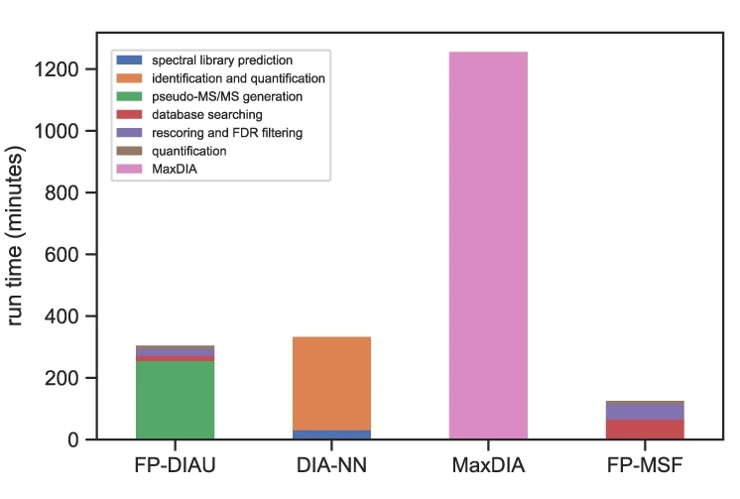
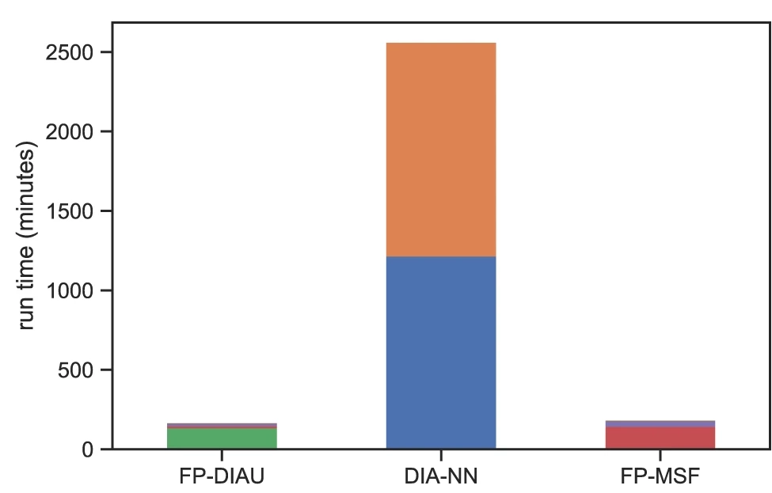
DIA data analysis
Proteome
Phosphoproteome
Windows desktop: Intel Core i9-10900K, 3.70 GHz, 10 cores, 20 logical processors, 128 GB of memory
Yu et al., Nat. Commun. (2023)

Slide 17
What about comment-line interface?
High performance computing clusters
Webservers
Processing many jobs in batches
Usage:
fragpipe --headless --workflow <path to workflow file> --manifest <path to manifest file> --workdir <path to result directory>
Options:
-h
--help # Print this help message.
--headless # Running in headless mode.
--workflow <string> # Specify path to workflow file.
--manifest <string> # Specify path to manifest file.
--workdir <string> # Specify the result directory.
--dry-run # (optional) Dry run, not really run FragPipe.
--ram <integer> # (optional) Specify the maximum allowed memory size.
--threads <integer> # (optional) Specify the number of threads.
--config-msfragger <string> # (optional) specify the location of the MSFragger jar file.
--config-ionquant <string> # (optional) specify the location of the IonQuant jar file.
--config-philosopher <string> # (optional) specify the location of the Philosopher binary file.
--config-python <string> # (optional) specify the location of the Python directory.

Slide 18


Acknowledgements
Nesvizhskii group:
Alexey Nesvizhskii (PI)
Andy Kong
Guo Ci Teo
Dmitry Avtonomov
Sarah Haynes
Daniel Polasky
Daniel Geiszler
Kevin Yang
Ginny Xiaohe Li
Kai Li
Collaborators:
George Rosenberger (EasyPQP)
Lukas Käll (Percolator)
David Shteynberg (PTMProphet)
Vadim Demichev (DIA-NN)
Keriann Backus Lab (UCLA)
Stephan Hacker Lab (Leiden U)
Ralser Lab (Francis Crick)
Ying Zhu (Genentech)

Slide 19
Thank you
Q & A

