Slide 1
A novel SDS-based sample preparation strategy for proteomic and PTM research
Chuan-Qi Zhong
Xiamen University

Slide 2
Outline
Establishment of SDS-cyclodextrin aided sample preparation (SCASP)
Establishment of SCASP-phos
Application of SCASP and SCASP-phos in PD1 signaling pathway

Slide 3
Establishment of SCASP

Slide 4
SCASP has excellent performance and producibility

Slide 5
SCASP surpassed other SDS-based methods
10ug SDS-containing protein samples
Add cyclodextrin
Filter
Add acetone
Add beads
Add trypsin
& digestion
Multiple
centrifugation
Precipitation&
centrifugation
Washes &
centrifugation
Add trypsin
& digestion
Add trypsin
& digestion
Add trypsin
& digestion

Slide 6
SCASP can handle biological samples from various sources

Slide 7
SCASP offers advantages in handling challenging samples

Slide 8
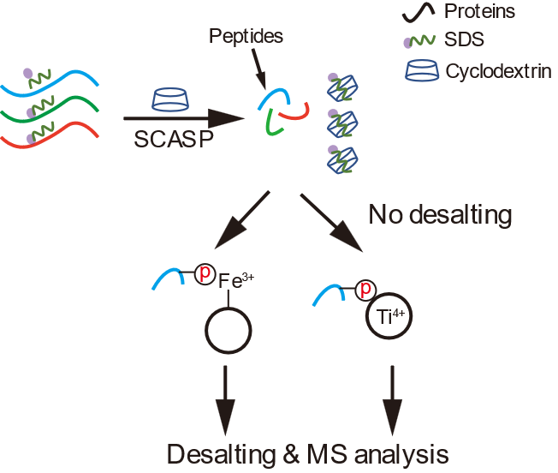
Establishment of SCASP-phos

Slide 9
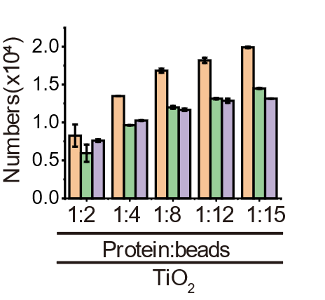
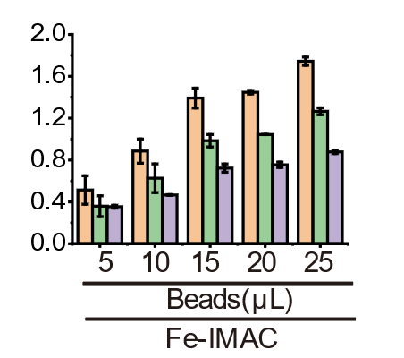
SCASP-phos is compatible with TiO₂ and Fe-IMAC

Slide 10
SCASP-phos outperforms easy-phos
Easy-phos
Easy-phos
SCASP-phos
SCASP-phos

Slide 11
SCASP-IMAC and TiO₂ can be conducted tandemly
SCASP-IMAC
IMAC-TiO₂
SCASP-IMAC
IMAC-TiO₂

Slide 12
Generation of PD1 KO MDA-MB-231 cell line

Slide 13
The workflow for proteomics and phosphoproteomics analysis

Slide 14
DIA-NN based library-free strategy for diaPASEF data analysis
 | Proteins | Peptides | Localized phosphosites
Proteomics | 7613 | 91166 | NA
Phosphoproteomics | 5562 | 23565 | 14963

Slide 15
Quantitative proteomics and phosphoproteomics shows good reproducibility

Slide 16
Differential expression analysis of regulated proteins by PD1

Slide 17
Proteomics and phosphoproteomics reveal that PD-1 deficiency probably blocks TNF secretion

Slide 18
Future plan
Development of SCASP-ubi, SCASP-acetyl and SCASP-glyco
Application of SCASP sample preparation for biological signaling pathways

