Slide 1


Mapping Cellular Interactome by
Cross-linking Mass Spectrometry
Fan Liu
Leibniz-Forschungsinstitut für Molekulare Pharmakologie (FMP)
30.08.2023

Slide 2

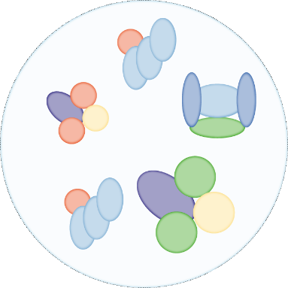

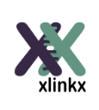

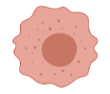
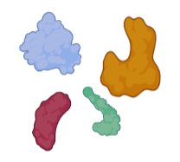
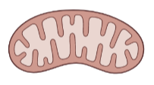
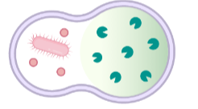
Cross-linking mass spectrometry (XL-MS)
Cross-linking
Digestion
LC/MS
Cross-link
identification

Slide 3
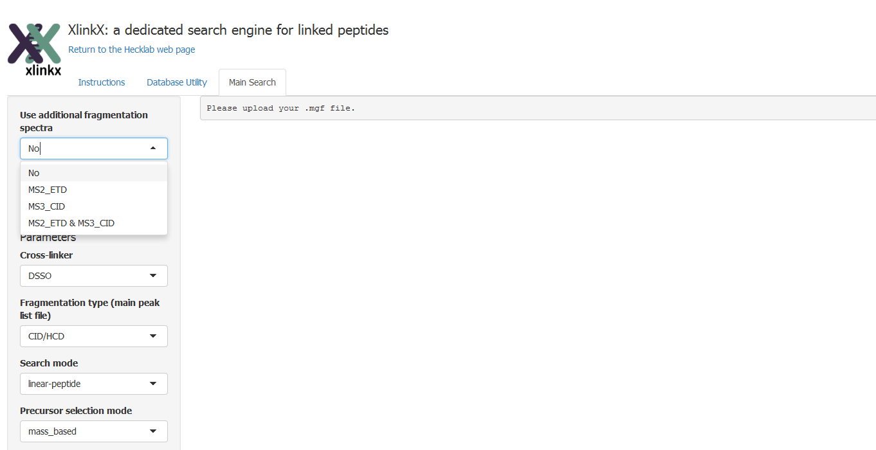
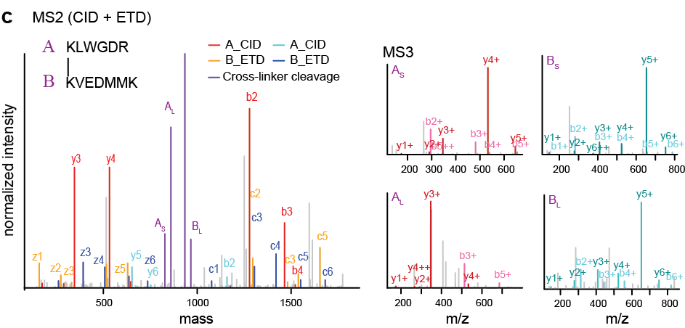
Development of computational pipeline for MS-cleavable cross-linkers
before 2015
(~2,000 cross-links)
2017
(~4,000 cross-links)
2019
(~6,000 cross-links)
2021
(~20,000 cross-links)
2022
(~30,000 cross-links)
2023
(???)
Year
Number of cross-links
Liu F. et al, Nat Methods, 2015; Liu F. et al, Nat Commun, 2017

Slide 4
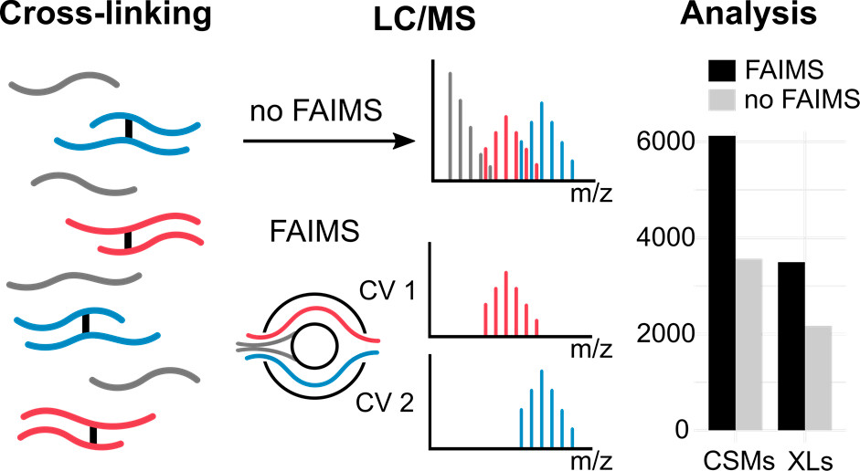
Implementation of ion mobility separation for cross-links
before 2015
(~2,000 cross-links)
2017
(~4,000 cross-links)
2019
(~6,000 cross-links)
2021
(~20,000 cross-links)
2022
(~30,000 cross-links)
2023
(???)
Year
Number of cross-links
Schnirch L. et al., Liu. F., Anal Chem, 2019

Slide 5
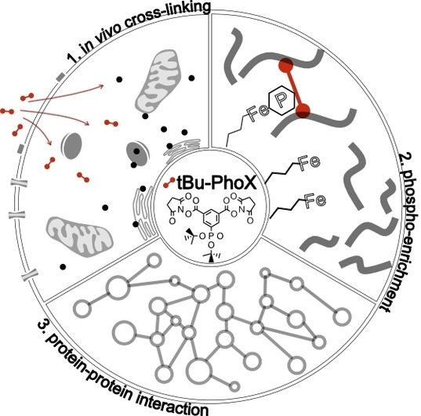
IMAC enrichable cross-linkers
Before 2015
(~2,000 cross-links)
2017
(~4,000 cross-links)
2019
(~6,000 cross-links)
2021
(~20,000 cross-links)
2022
(~30,000 cross-links)
2023
(???)
Development of a membrane permeable and IMAC enrichable cross-linker
Year
Number of cross-links
Jiang PL. et al., Liu. F., Angew Chem, 2021

Slide 6
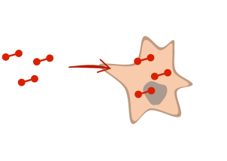
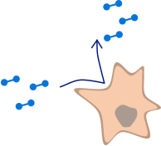
IMAC enrichable cross-linkers
Chemical structures of PhoX and tBu-PhoX
PhoX
tBu-PhoX
Steigenberger B. et al., Schelterma. R., ACS Cent. Sci. 2019
Jiang PL. et al., Liu. F., Angew Chem, 2021
Available at Thermo Fisher Scientific
https://www.thermofisher.com/order/catalog/product/A52287
Steigenberger B. et al., ACS Cent. Sci. 2019 & Jiang PL. et al., Angew Chem. 2021

Slide 7
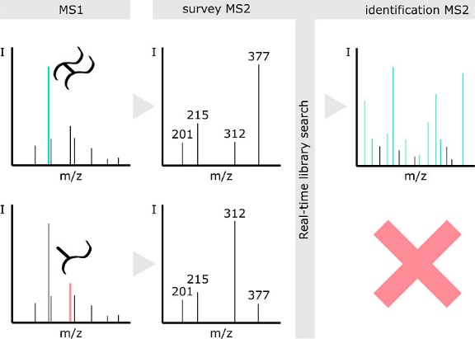
Real-time library search assisted cross-link identification
Before 2015
(~2,000 cross-links)
2017
(~4,000 cross-links)
2019
(~8,000 cross-links)
2021
(~20,000 cross-links)
2022
(~30,000 cross-links)
2023
(???)
Year
Number of cross-links
Ruwolt M. et al, Anal Chem. 2023

Slide 8

What’s NEXT
Before 2015
(~2,000 cross-links)
2017
(~4,000 cross-links)
2019
(~8,000 cross-links)
2021
(~20,000 cross-links)
2022
(~30,000 cross-links)
2023
(???)
Accumulatively 400,000 cross-links, 25,000 PPIs
Year
Number of cross-links

Slide 9
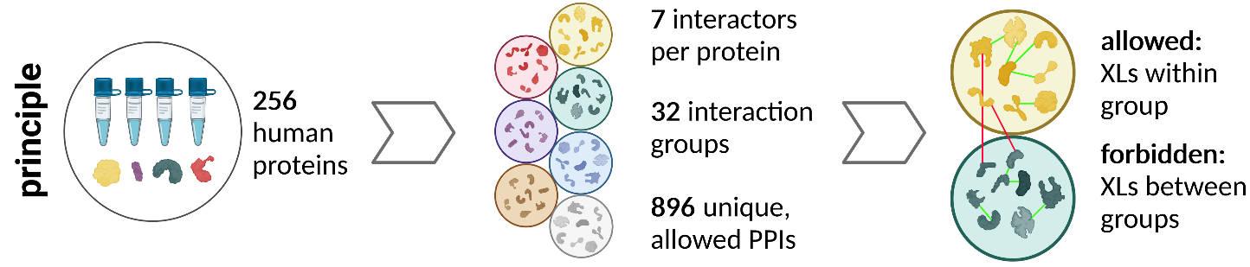
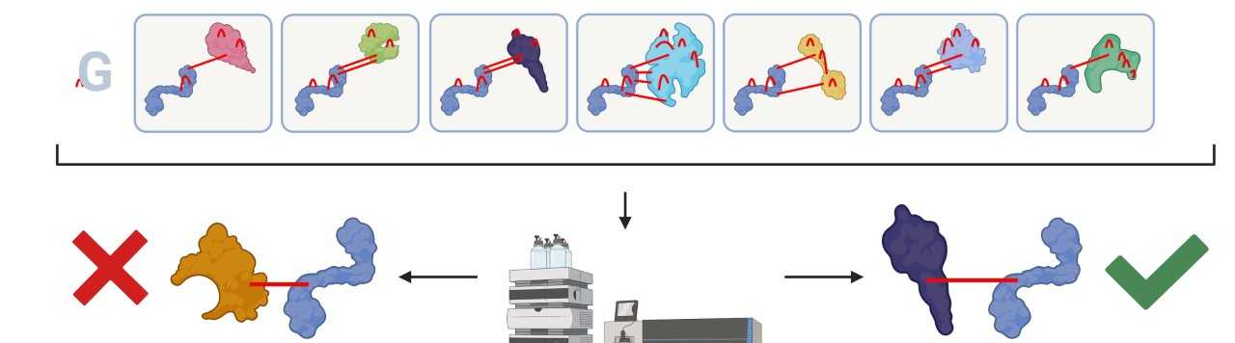
Generation of ground truth dataset
Mass spectrometer
Real FDR
  Target / Decoy strategy + known interactions

Slide 10
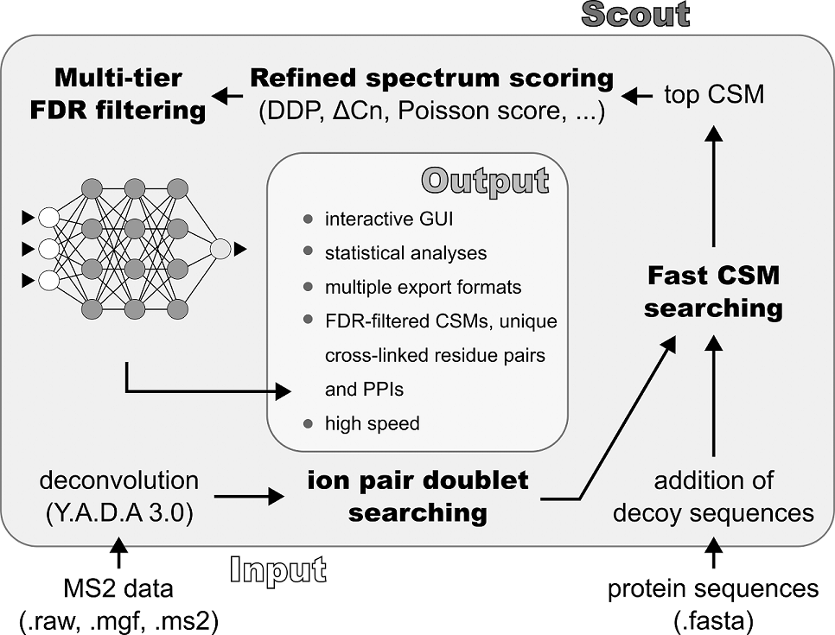
Cross-link search engine - Scout
FDR control at all levels: CSM → Peptide pair → Residue pair → PPI

Slide 11
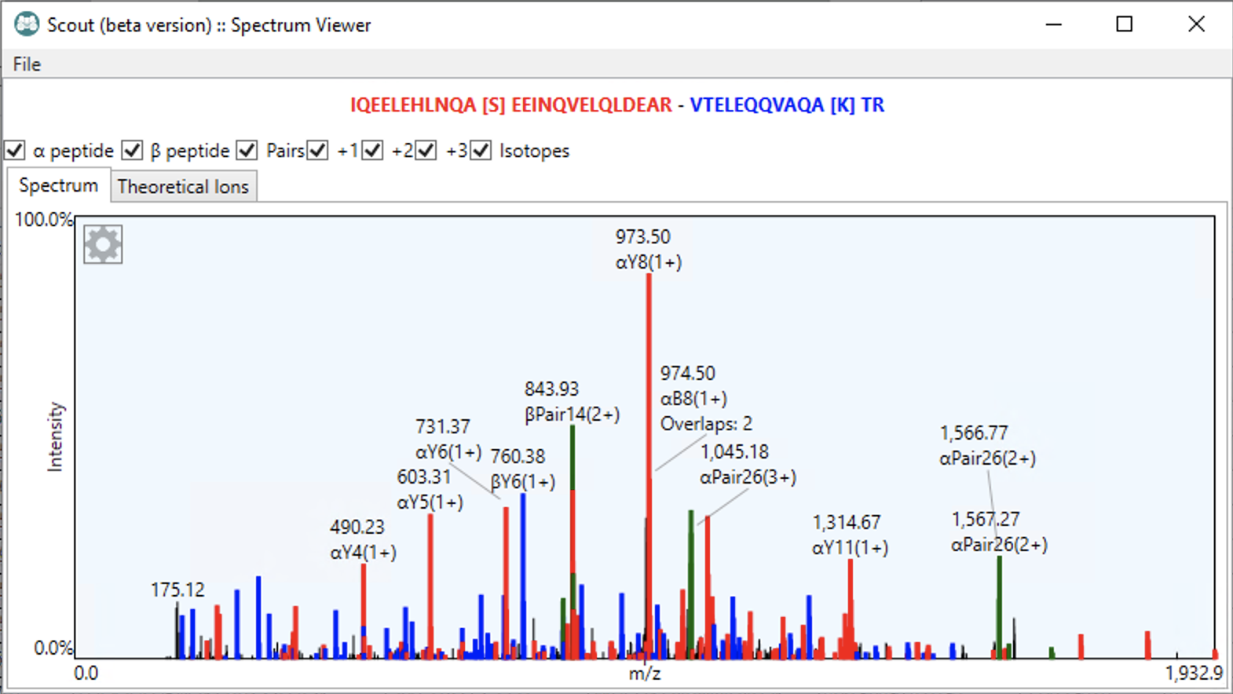
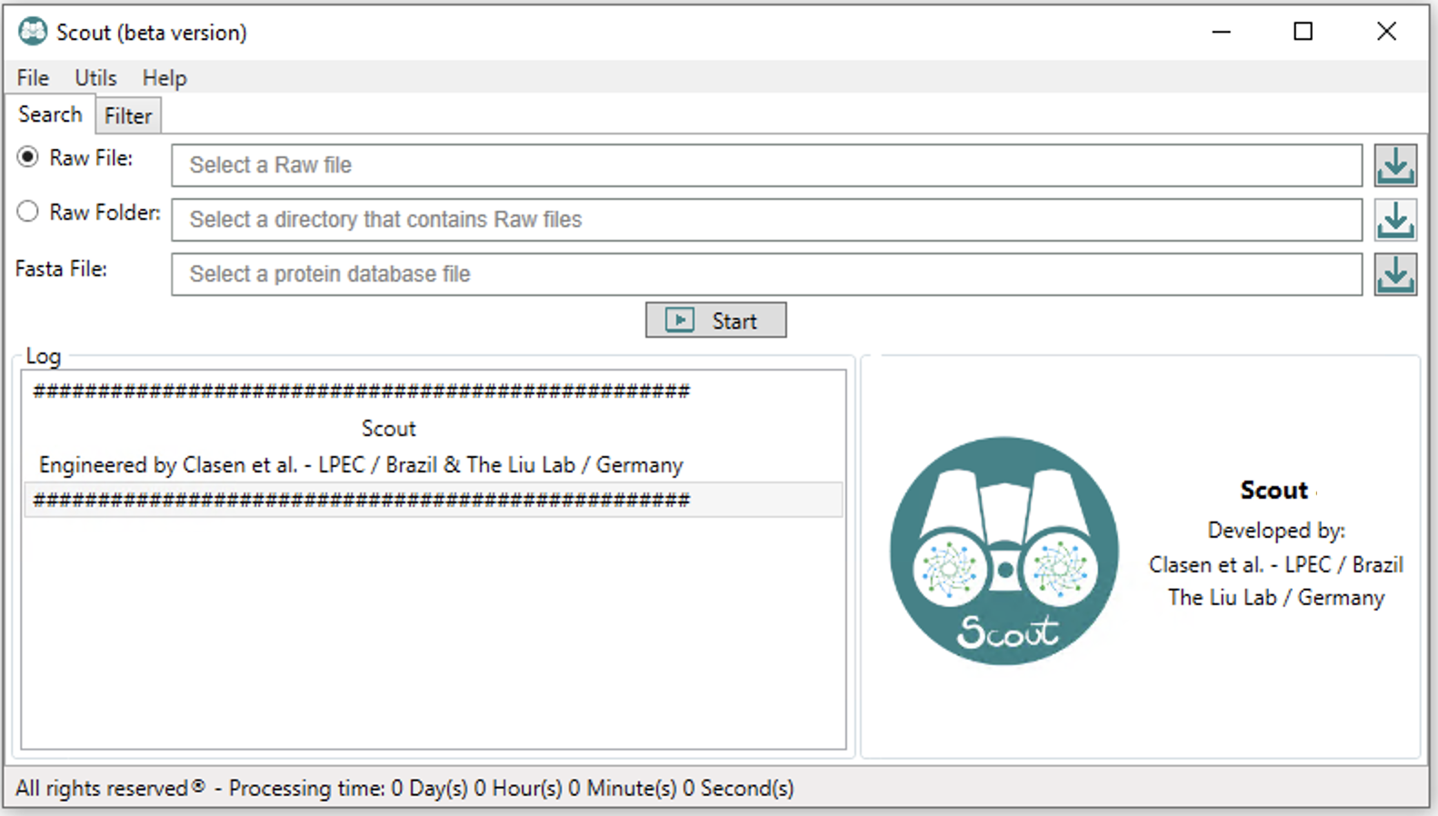
Cross-link search engine - Scout
Main interface
Results

Slide 12
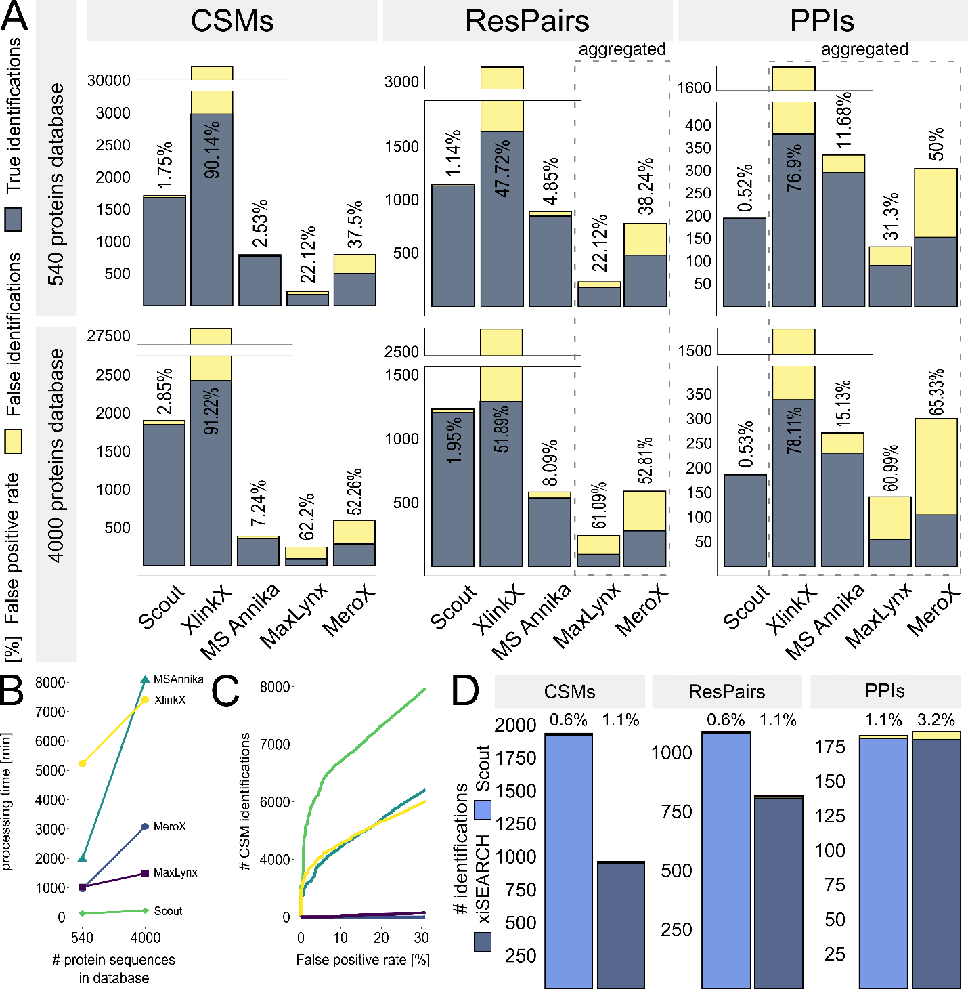
Comparison of different search engines
Number of identifications at all levels (inter-link only), filtered at 1% FDR if the corresponding software has this option

Slide 13
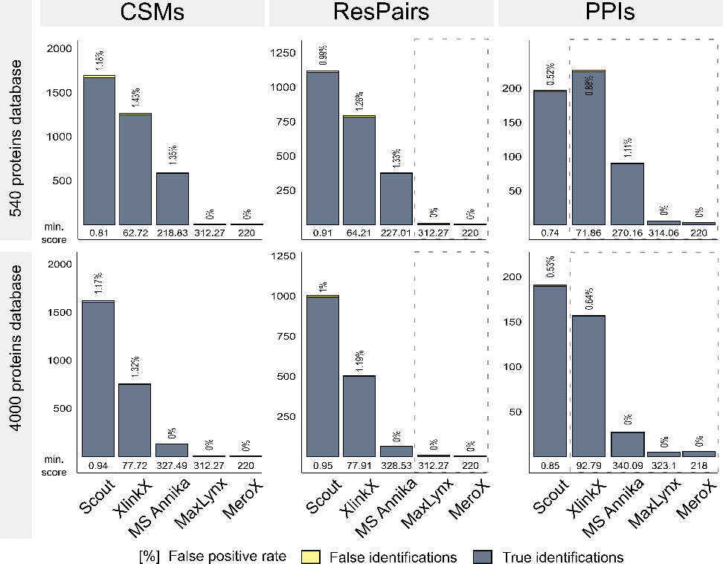
Comparison of different search engines
Number of identifications at all levels (inter-link only), filtered to 1% empirical FDR by post-processing

Slide 14
Comparison of different search engines – Scout vs XiFDR
Number of identifications at all levels, filtered at 1% FDR

Slide 15
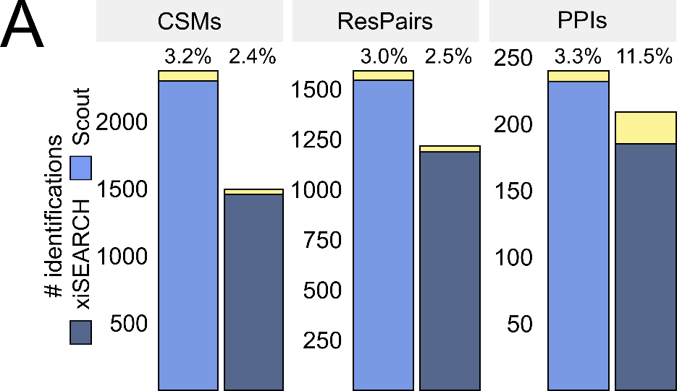
Comparison of different search engines – Scout vs XiFDR
Number of identifications at all levels, filtered at 5% FDR

Slide 16
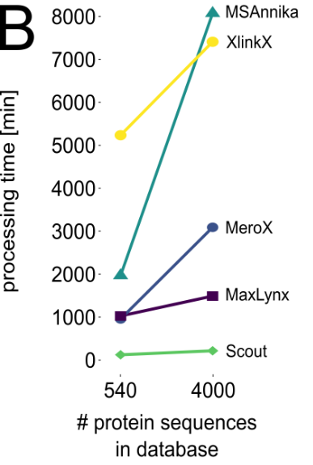
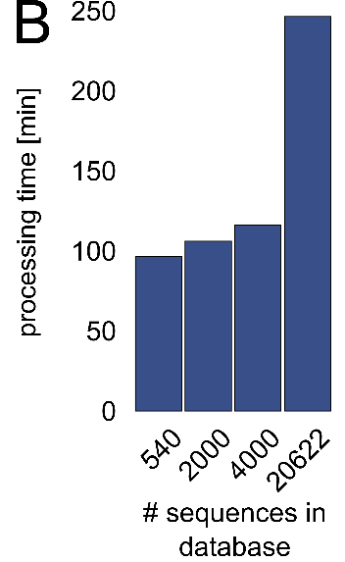
Comparison of different search engines
Search speed

Slide 17
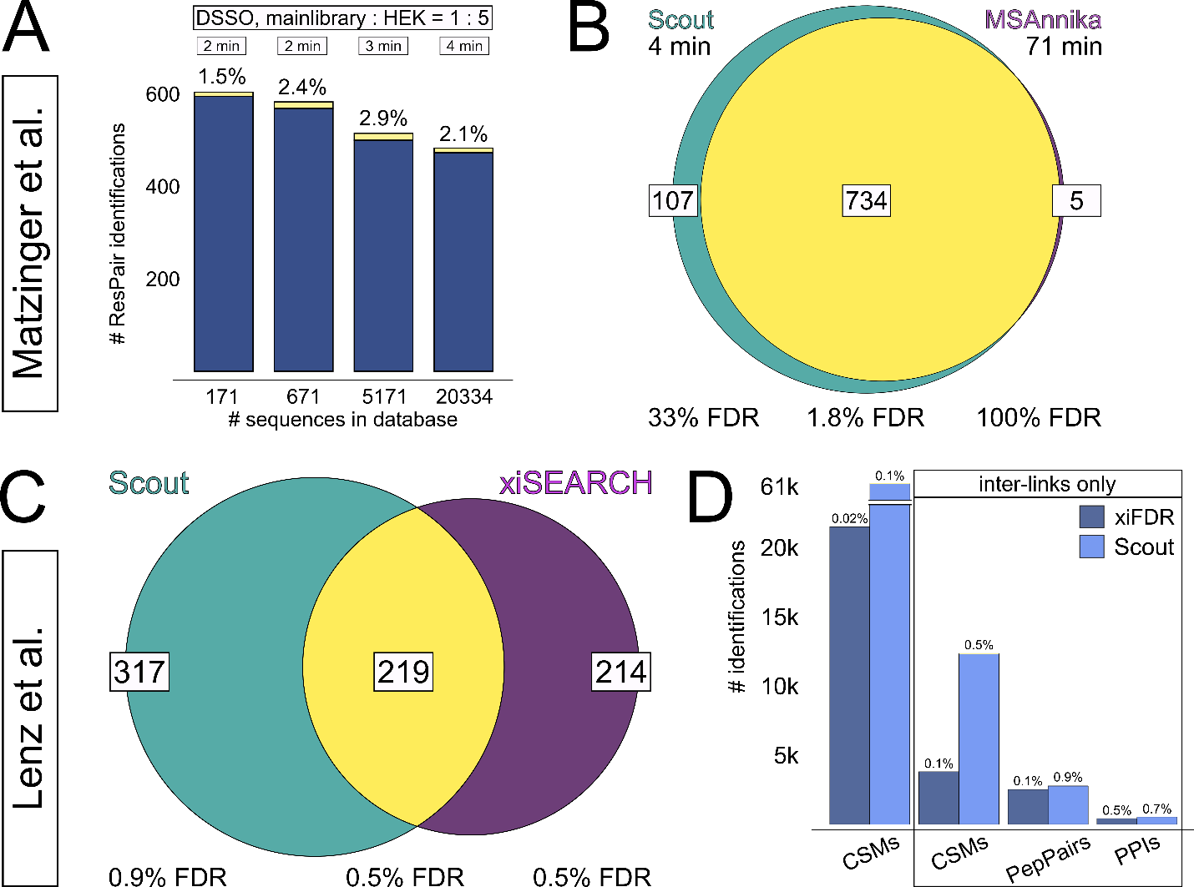
Comparison of different search engines
Scout vs MSAnnika using the Matzinger’s peptide-based XL standard

Slide 18
Comparison of different search engines
Scout vs XiFDR using the Lenz’s PPI benchmarking XL dataset

Slide 19
Biological applications

Slide 20
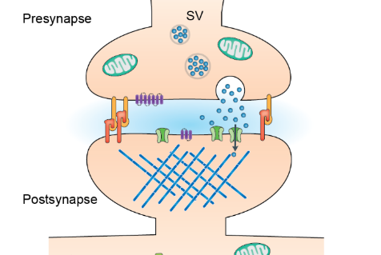

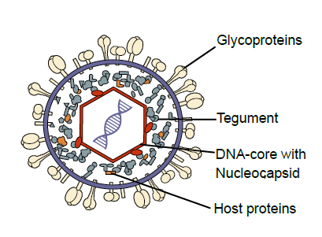
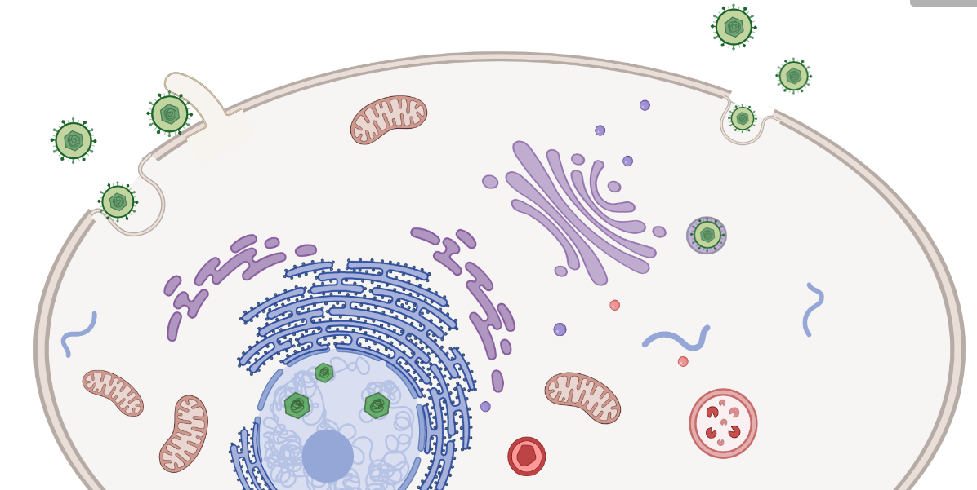
XL-MS applications
The mitochondrion
The cell
The synapse
The virion particle
Virus-host interactions

Slide 21
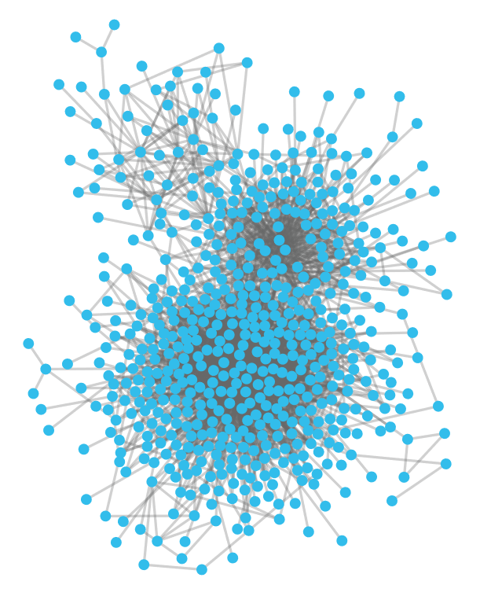
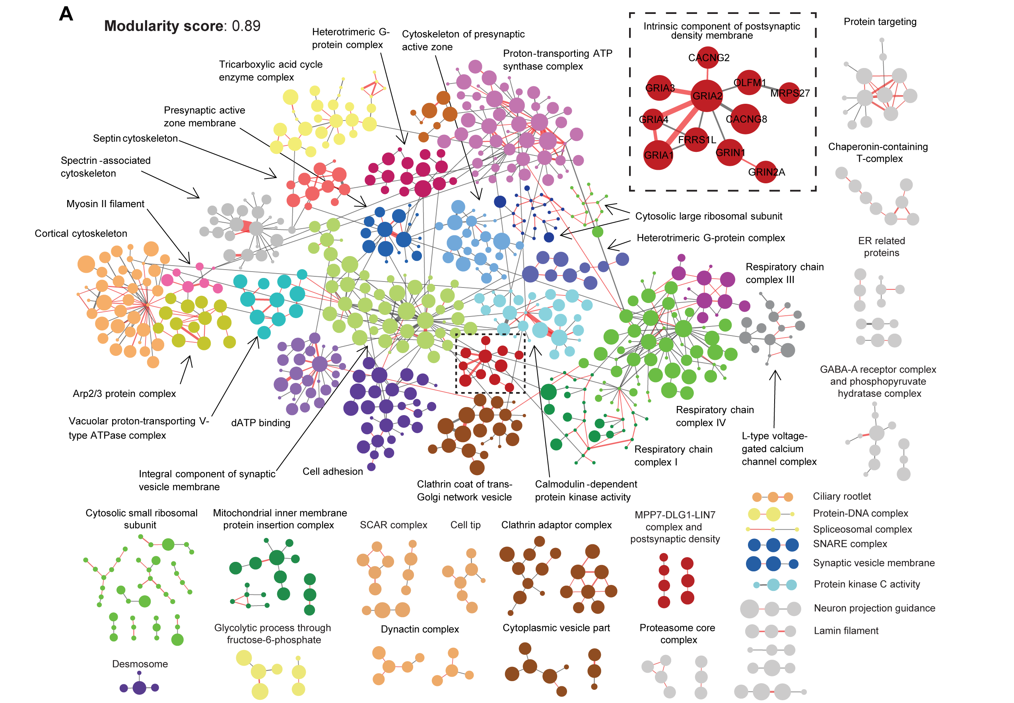
XL-MS-based interactomes

Slide 22
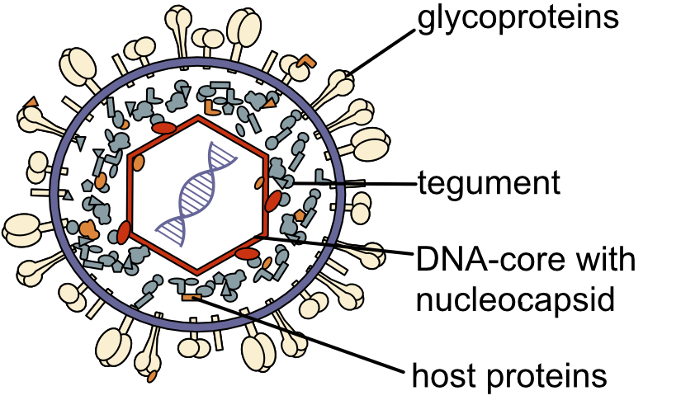
The HCMV virion
Kschonsak et al, Sci Adv, 2022
Kschonsak et al., Cell, 2021
Liu et al., Sci Adv, 2021
Spatial organization?
Interactions?
Yu et al., Science, 2017
Liu et al, Nat Commun, 2021
Layer-specific incorporation?
Recruitment mechanisms?
Significance?
Diameter: ~ 200 nM
Composition: 46-82 viral proteins, 71 -1,500 host proteins

Slide 23
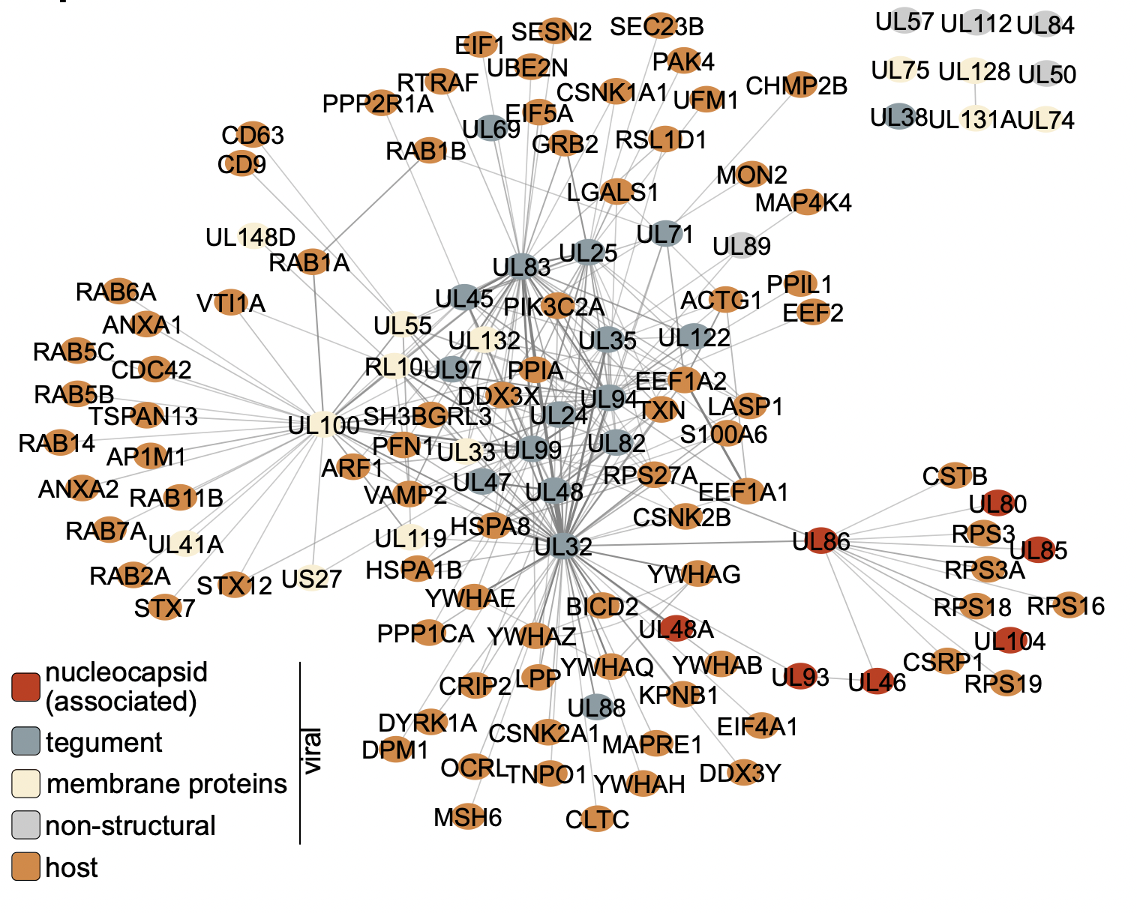
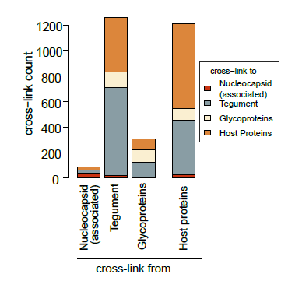
The intra-virion interaction network of HCMV
~7000 cross-links
46 viral proteins
148 host proteins
Bogdanow B., et al., Liu. F., Nature Microbiology, 2023

Slide 24
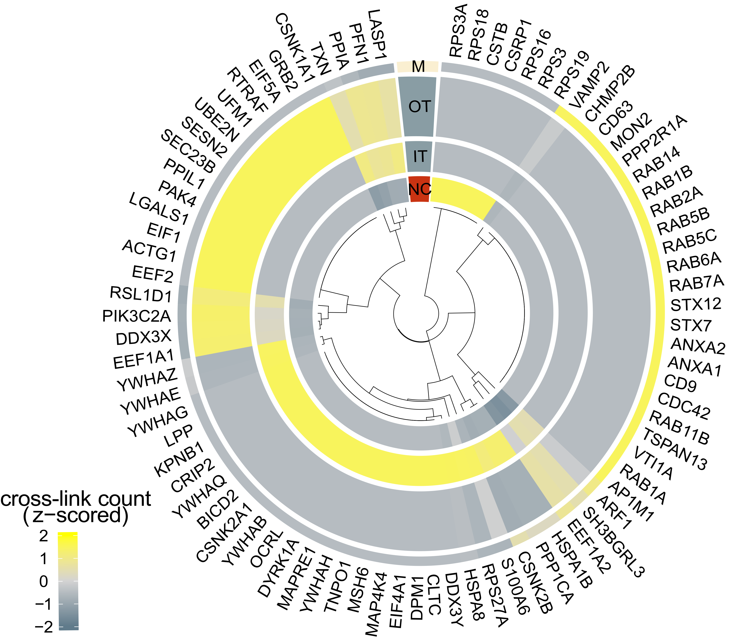
Cross-link reveals spatial arrangement of host proteins
NC: Nucleocapsid
IT: inner tegument
OT: outer tegument
M: virion membrane
Bogdanow B., et al., Liu. F., Nature Microbiology, 2023

Slide 25

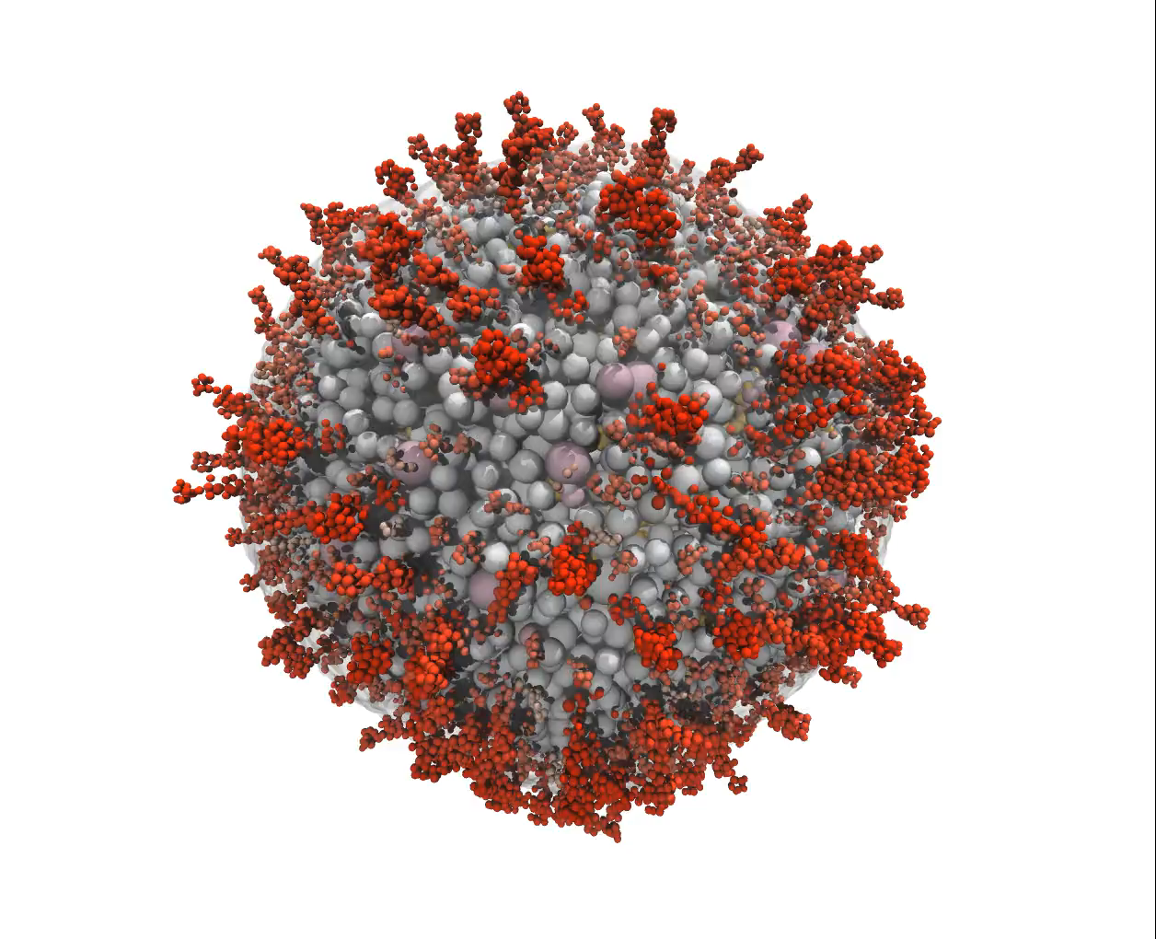
Building a coarse-grained model of HCMV virions
Spatial organization by XL-MS
Pairwise interaction probability estimated by XL-MS
Protein copy numbers
Available structures from PDB or alphafold models
Sequence information (e.g. to find the transmembrane domains of envelope proteins)
Bogdanow B., et al., Liu. F., Nature Microbiology, 2023

Slide 26





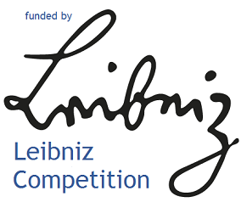

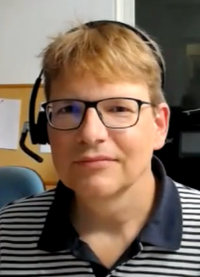
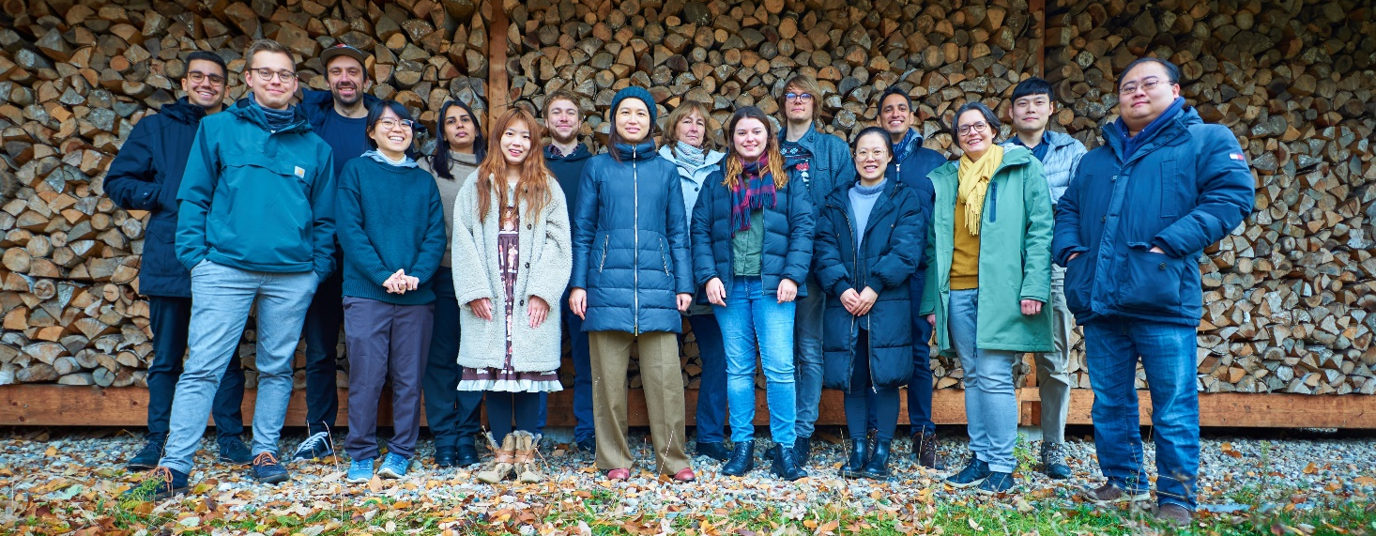



Acknowledgements
Structural Bioinformatics and Protein Design
Jonas Protze
Gerd Krause
Laboratory for Pediatric Molecular Biology
Lueder Wiebusch
Iris Gruska
Barbara Vetter
Artificial Intelligence for the Sciences
Mohsen Sadeghi
Cellular Imaging
Svea Hohensee
Dmytro Puchkov
Martin Lehmann
Mohsen Sadeghi
Boris Bogdanow
The Liu Lab at the FMP
Lueder Wiebusch

Slide 27




Acknowledgements
Lab. Structural and Computational Proteomics – ICC/Fiocruz – Brazil
Milan A. Clasen
Louise U. Kurt
Paulo C. Carvalho
We are hiring!
www.theliulab.com
Tao Chen
Wei Zhang
Shuai Wang
Milan A. Clasen
The Liu Lab at the FMP
Diogo Borges
Max Ruwolt

