Slide 1




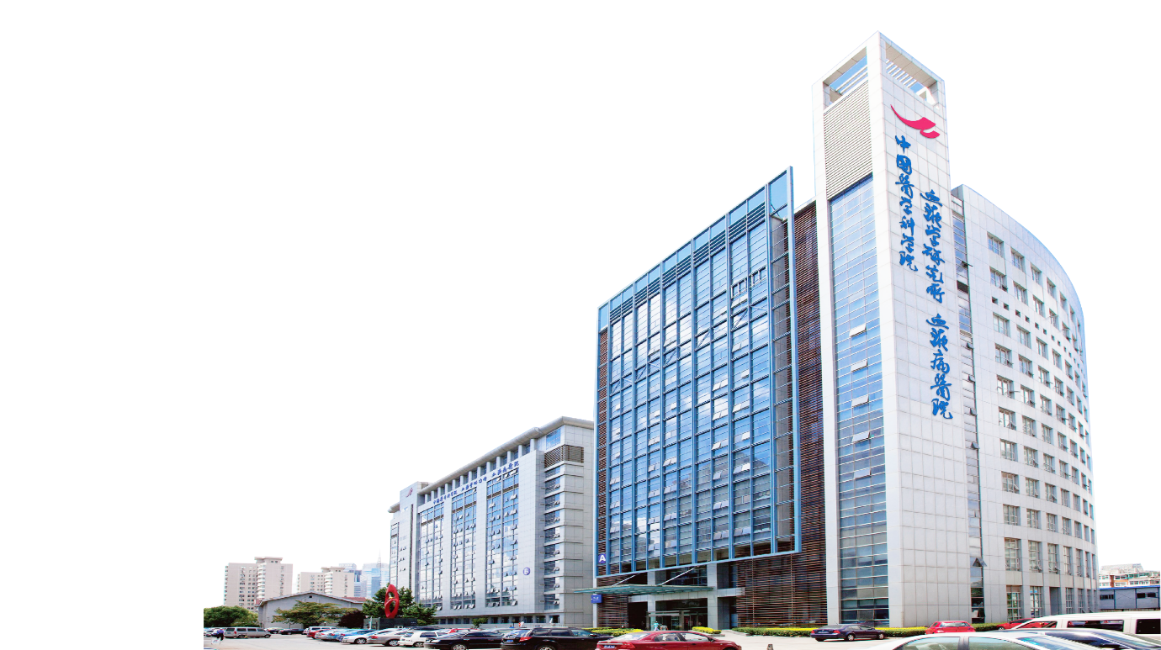
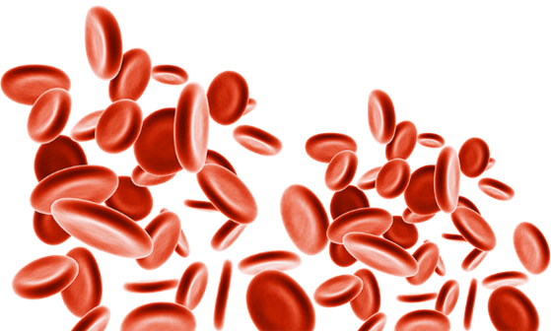
2023-CNCP
Blood Ecosystem Approach to Dissect Systemic diseases
王洪
中国医学科学院血液病医院
（中国医学科学院血液学研究所）
天津市细胞生态海河实验室
2023-08-31

Slide 2
研究方向
“卡脖子”的质谱技术：
美国质谱临检: >15%
中国质谱临检: 1%-2%
美国LC-MS/MS检测方法400多种
中国LC-MS/MS检测方法40多种
质谱技术开发
临床质谱检测
多组学
整合
蛋白质组学

Slide 3
前期工作基础：研发前沿的蛋白质组学技术
为推动基于质谱的临床蛋白质组学筑基
临床蛋白质组学技术的关键
筛查深度
灵敏度
通量
1
千万
2
常规
方法
5000
百万
10
12000+
<1万
29
我们的
方法
覆盖到的
蛋白质数量
检测所需
细胞量
单个实验
分析样本数量
Nature Communications. 2019; Genome Biology. 2021; Journal of Proteome Research. 2015; Clin. Proteomics. 2019; PNAS 2023
Notes:
我前期主要聚焦蛋白质组学技术对临床队列样本研究，在底层技术方面做了一系列的研发工作，克服了一些重要的技术瓶颈，包括筛查深度，灵敏度和通量。目前最新的技术，深度上能够定量分析超过一万两千种蛋白质，覆盖几乎所有人体细胞内表达的蛋白质，同时我们把技术的灵敏度提高了成百上千倍，极大的减少了对临床样本量的需求，这点对珍贵临床样本的研究及其重要，很多之前由于样本量的原因没条件探索的领域空白现在都可以通过我们的新技术进行研究了。通量上我们目前单个实验能同时分析29个样本。

Slide 4
其他质谱技术的研发
Whole human cell deep proteomic profiling pipelines:
Protein Identification(1. Technology; 2 software):
< 5,000 to > 10,000
Protein Quantification:
1. Multiplexing; 2. Accuracy
Post-data processing:
Multiomics integration and network analysis
Wang H. JPR.2015;
Pagala VR. Methods Mol Biol. 2015
Wang X. MCP. 2014; Bai B. JPR. 2014
Dey KK. Clin Proteomics. 2019
High AA. J Vis Exp. 2017;
Niu M. Anal Chem. 2017
Li Y. JPR. 2016
Kennedy DE, Nat. Immunology. 2020
Bai, B, Neuron, 2020
Wang H. Nat. Comm. 2019
Wang B. Mol Cell. 2019
Du X. Nature. 2018
Cheng Y. Nat Neurosci. 2018
Tan H. Immunity. 2017
Gong J. Cell. 2017
Li Z. PNAS. 2017
Churchman ML. Cancer Cell. 2015
Bai B. PNAS. 2013
Deep protein post-translational modification profiling pipelines:
Protein PTM:
Phosphorylation ( >40,000)
Ubiquitination ( < 10,000 )
Protein Quantification:
1. Multiplexing
2. Accuracy
Post-data processing: Multiomics integration and network analysis
Gao Y. MCP. 2016
Tan H. Proteomics. 2015
Bai B. Methods Mol Biol. 2017
Wu Z. Methods Mol Biol .2014
Ma X. Nature. 2020
Yang SW, Mol Cell. 2020
Yang X. Nat. Neurosci. 2019
Stewart E. Cancer Cell. 2018
Wang Z. Nature. 2018
Shi H. Immunity. 2018
Zeng H. Sci Adv. 2018
Joo JH. Mol Cell. 2016
Metabolomics pipelines:
Sample processing
Software development
Xie B. Ana Chem. 2018
Jones DR. Anal Chem. 2014
Shen J. JPR. 2018
Wang X. JPR. 2018
Biofluid proteome for biomarker:
Ultra-prefractionation
Key KK, Wang H, Clinic Proteomics. 2019
Wang H, Mol. Neurodegeneration. 2020
AP/IP-MS proteomics and others:
Lee KH. Cell. 2016; Martinez J. Nat Cell Biol. 2015; Mertz J. MCP. 2015
Notes:
。。。除了这些之外，过去十年间我们实验室和中心还开发了多个前沿蛋白质组学平台,这些平台在各种生物医学领域得到了非常广泛的应用 。 。。。 包括蛋白质翻译后修饰的深度筛查平台，比如蛋白磷酸化，乙酰化，泛素化等等，。。。代谢组学平台, 。。。血液和脑脊液等各种人体体液中筛查各种疾病诊断和预后的蛋白质生物标记物的平台，。。。。以及蛋白质相互作用组的筛查平台 等等。 由于时间的关系我在这里就不一一具体深入了

Slide 5

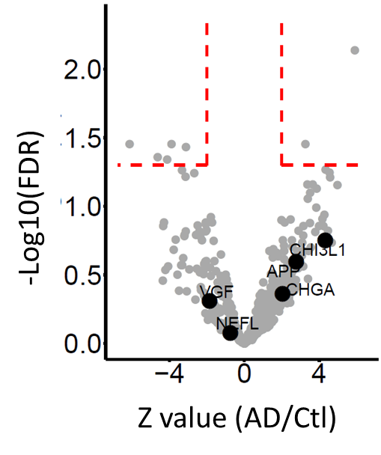
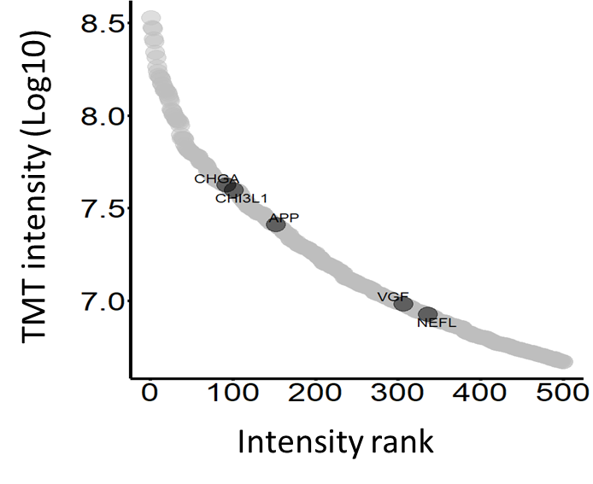
Developed a Deep Serum Proteomic Technology
血浆蛋白质组学领域公认的技术难点 — 深度：
现状：极浅的筛查深度 （只能检测到血浆中丰度最高的~500蛋白质）
研发新技术： 检测～5000 血浆蛋白质，是已报到最深度的基于质谱的血液biomarker筛查平台之一
成果：AD患者血浆中首次揭示大量线粒体标志物
丰度排序的中位数:～3000
常规方法
我们的新技术
常规技术
Mol. Neurodegeneration. 2020; Clin. Proteomics. 2019; Peng J, Wang H, Dey KK, S88435 1280US.P1(0060.0)

Slide 6
蛋白质组学和代谢组学软件工具的开发
JUMP Software Suite
JUMPg
蛋白质基因组学软件
JUMPp
蛋白质数据库搜索引擎
JUMPm
代谢组数据库搜索引擎
JUMPpf
蛋白质ID质控
基于标记的
代谢组分析
基于非标记的
代谢组分析
JUMPpq
蛋白质组定量
Wang X. MCP. 2014
Li Y. JPR. 2016
Niu M. Anal Chem. 2017
Shen J. JPR. 2018
Wang X. JPR. 2018
Wang X. Metabolites. 2020
JUMPpn
蛋白质组网络分析

Slide 7
同行证实及学界认可
合作团队的代表成果：
Myasnikov A. Cell. 2021; Maxwell BA. Science. 2021; Long L. Nature.2021; Marti-Solano M. Nature. 2020; Ma X. Nature.2020; Du X. Nature. 2018; Gong J. Cell. 2017; Wang Z. Nature. 2018
免疫学权威专家迟洪波教授采用我新研发的技术首次系统解析了免疫细胞的关键代谢调控机制
Nature. 2018 558(7708):141-145-439
脑科学专家 Masashi Yanagisawa （HHMI）使用我的技术发现了睡眠的蛋白质磷酸化动态分子调控机制 Nature. 2018 558(7710):435-439
同行专家的认可与推荐：
“Tools needed to tackle some of the most pressing challenges we are currently facing in our research”
“开发的技术能够解决当前生物医学最关键的难题”
Peter C. Doherty
诺贝尔奖得主
““Innovation of JUMP…significantly improves the sensitivity of the search”
“发明的新技术JUMP明显的提升了蛋白质组检索的灵敏度”
Wade Harper 院士
哈佛大学医学院
Notes:
我们的合作团队应用我们的最新技术也做出了许多原创性的发现，包括霍华德修斯研究员 Masashi教授利用我们最新的技术发现了睡眠调控的关键机制。同时也得到了同行专家的认可，诺贝尔奖得主Peter Doherty评价我们开发的技术能够解决当前生物医学最关键的一些难题。包括Wader Harper 院士也对我们的工作进行了高度评价。

Slide 8
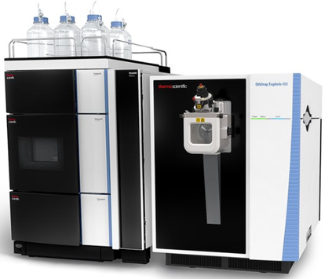
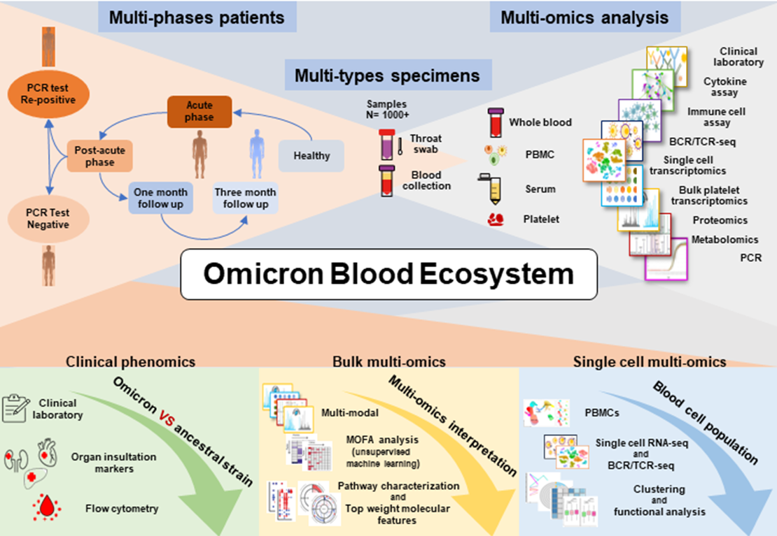
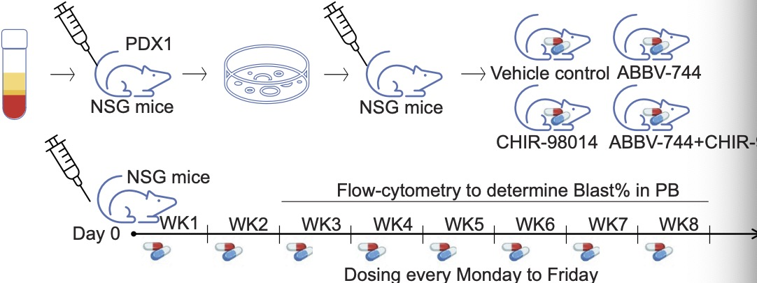
应用前沿组学技术解决生物医学关键问题
高深度
高通量
超灵敏度
1
多组学整合
指导个体化精准靶向治疗
3
前沿核心技术
解析系统性疾病的血液生态
2
靶向药耐药机理和联药策略
Nature Communications. 2019
Cancer Cell. 2018
成果已进入美国二期临床实验
Immunity. 2023
（封面故事）
PNAS. 2023
Notes:
有了这些技术后，我接下来花了大量精力来回答新技术能解决哪些生物医学问题。首先我通过蛋白质组深度筛查挖掘癌症治疗靶点，指导个体化精准治疗，其中一项成果已进入美国二期临床试验。通过结合CRISPR-Cas9功能基因组筛查和多组学挖掘白血病靶向药的耐药机制和联药新策略。时间关系，我着重介绍一下我回国之后从头开展的这个利用前沿技术解析血液生态系统的新工作。37

Slide 9
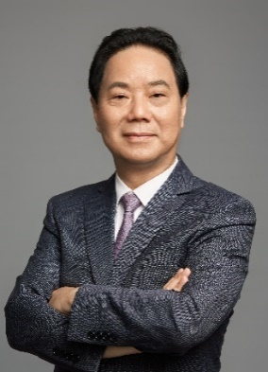

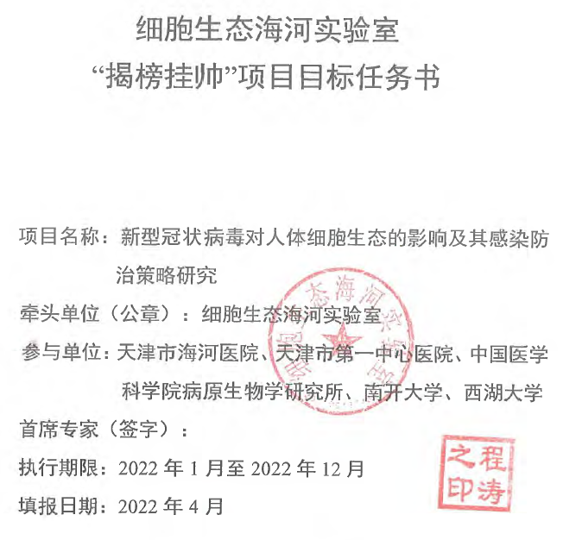
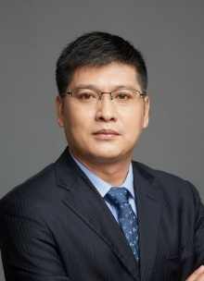
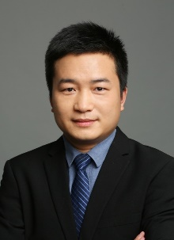
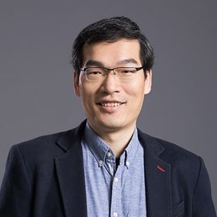
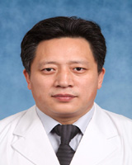
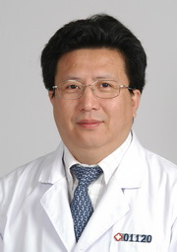
A Swift Launching of Collaborative Project
SARS-CoV-2 Omicron first emerged in Tianjin on the Chinese mainland on January 2022
The project were launched in March 2022 leading by top clinician and basic research experts
Dr. Tao Cheng
Jiaxi Zhou
Ping Zhu
Tiannan Guo
Ximo Wang
Zhongyang Shen
Notes:
variant of concern While host responses to the ancestral SARS-CoV-2 strain are well-described, those to the new Omicron variants remain largely unclear. CDC to develop policies to deal with the pandemic

Slide 10
What？？？
Host response dynamics along disease stages √
Re-positivity for viral RNA √
Notes:
variant of concern While host responses to the ancestral SARS-CoV-2 strain are well-described, those to the new Omicron variants are unclear.

Slide 11
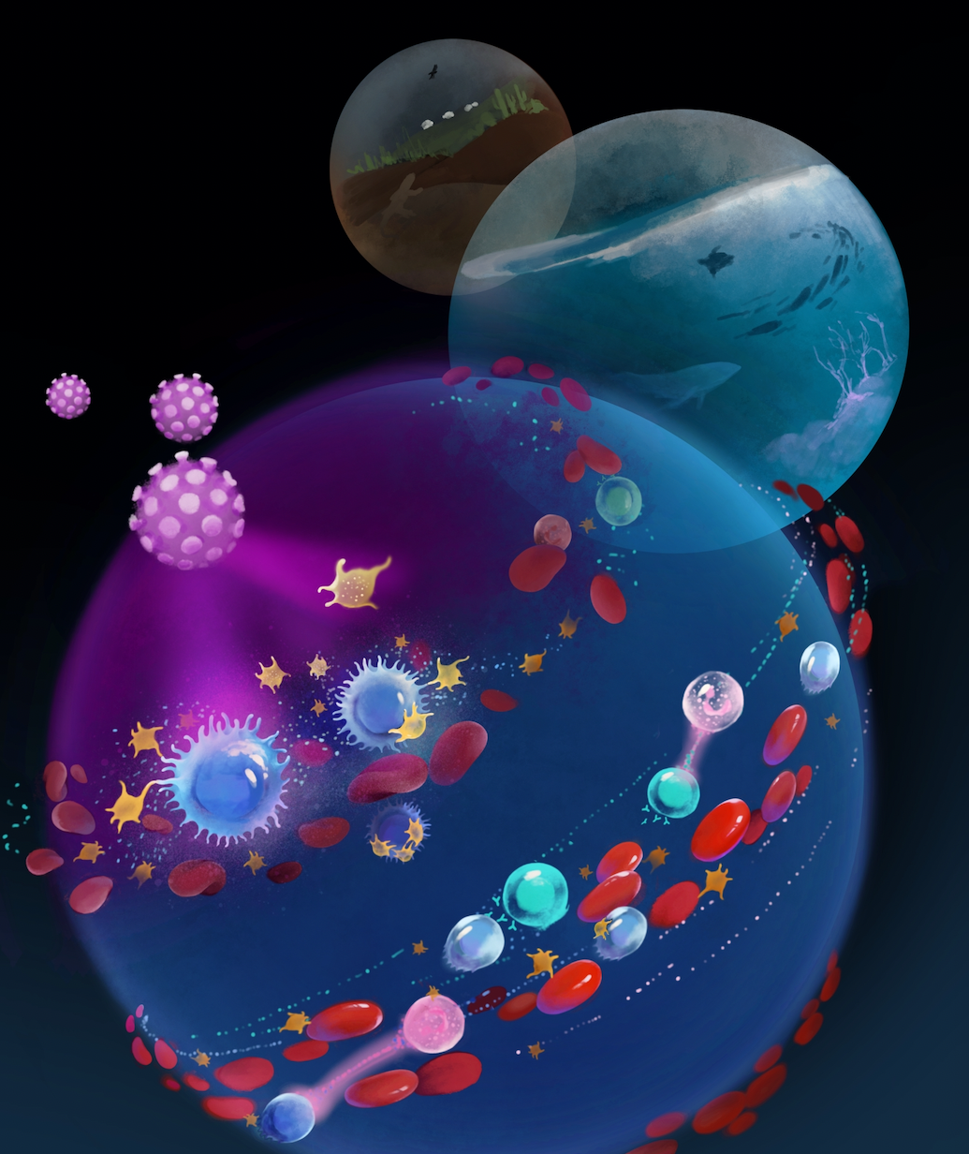
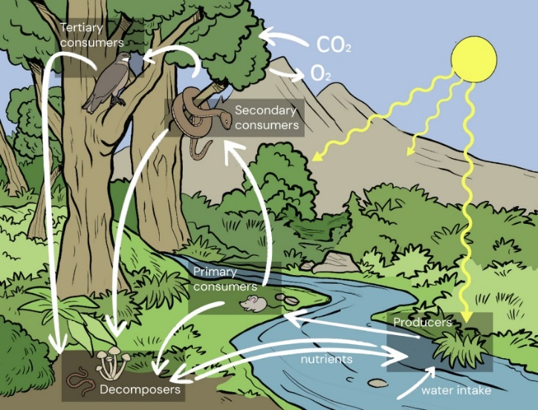
Blood Ecosystem Approach to Dissect Systematic Diseases
Ecosystem: All components and interactions in a defined environment or space
Chinese Medicine: “血浊致百病，血净病自消”
Blood Ecosystem
Ecosystem
Notes:
The blood ecosystem consists of complex and highly orchestrated interactions between distinct blood cells and diverse types of molecules in the plasma.

Slide 12
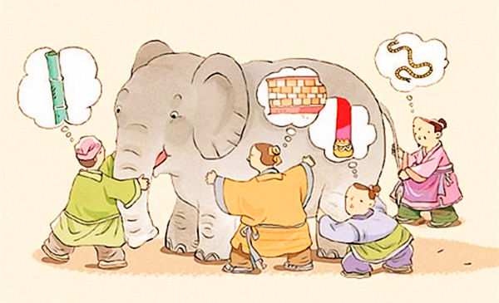
Blood Ecosystem Approach to Dissect Systematic Diseases
How???
Notes:
The blood ecosystem consists of complex and highly orchestrated interactions between distinct blood cells and diverse types of molecules in the plasma.

Slide 13
Scientific Question to address
1. Can we identify novel interactions and properties in the blood ecosystem in SARS-CoV2 Omicron infected patients?
components + interaction = property
3. Can we reveal mechanism underlying ‘re-positivity for viral RNA’ and provide strategies to screen and treat re-positivity?
Notes:
This “re-positivity” is a special clinical phenomenon involving the recurrence of detectable viral RNA that is not caused by reinfection
re-positive patients can have active viral replication, possibly resulting in active viral shedding

Slide 14
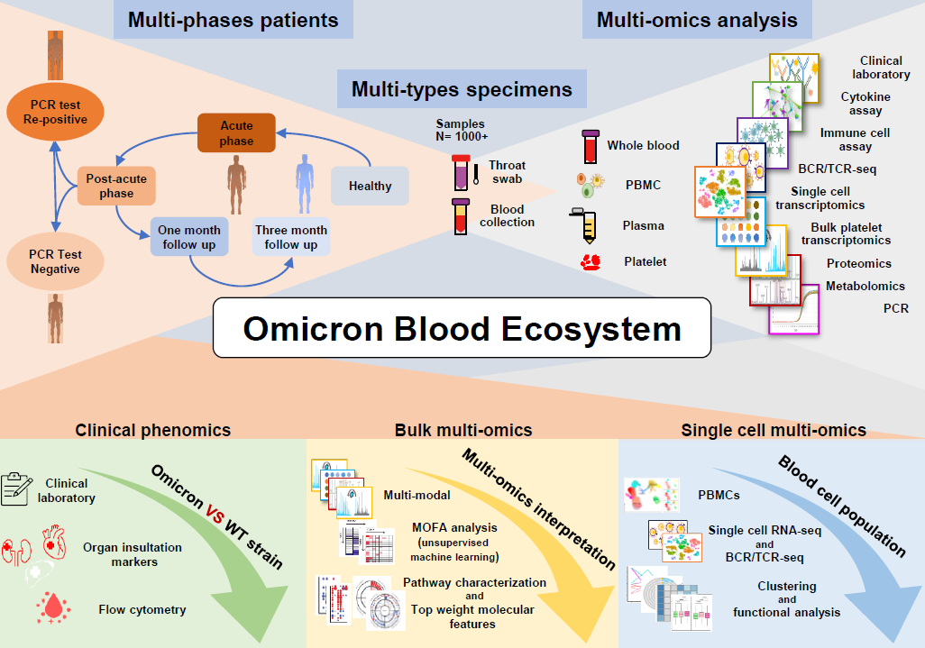
Multi-omics + Multi-specimens +Multi-phases
应用多组学整合分析从血液生态的维度解析系统性疾病（新冠Omicron）
Notes:
我们从血液生态的维度通过多组学分析对新冠患者进行了全面的描绘。样本层面我们分析了血液的各种细胞成分，血浆，以及血小板。组学维度上我们分析了各种临床检测，单细胞组学，及蛋白质组学和代谢组学在内的各种bulk组学。病人上我们覆盖了健康人，急性期，恢复期，一个月和3个月随访，总计分析了超过一千个样本的临床表现组，bulk多组学和单细胞多组学。

Slide 15
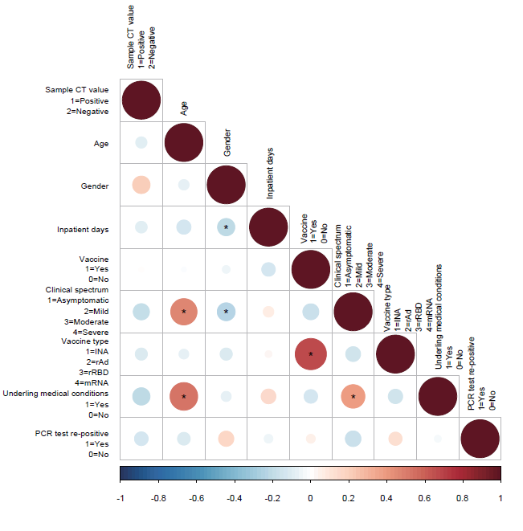
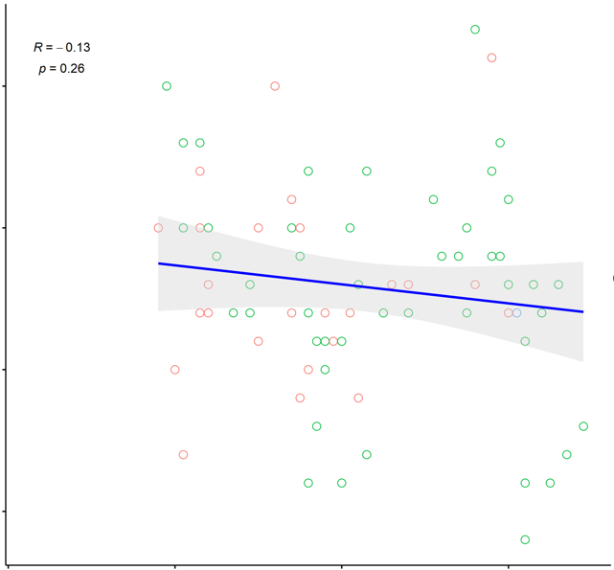
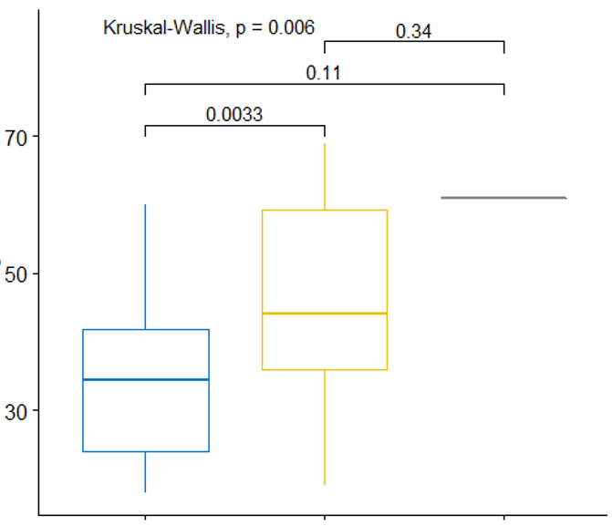
Older Patients with Underlying Medical Conditions Have More Severe Symptoms
Mild
Moderate
20
Duration of Hospitalization
10
20
40
60
Age
Age
Mild
Moderate
Severe

Slide 16
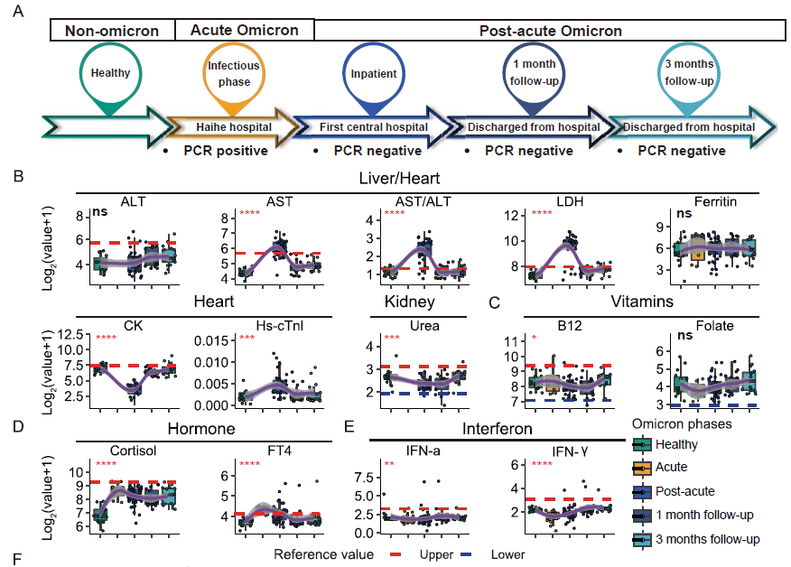
Globally Attenuated Host Responses in Omicron vs WT Strain

Slide 17
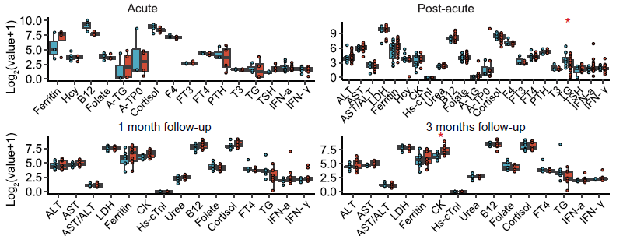

Molecular markers display no difference between Mild vs Moderate
Moderate patients show evidence of lower respiratory symptoms, while mild patients do not

Slide 18
Summary
1. Globally attenuated host responses in Omicron vs WT Strain
Notes:
This “re-positivity” is a special clinical phenomenon involving the recurrence of detectable viral RNA that is not caused by reinfection
re-positive patients can have active viral replication, possibly resulting in active viral shedding

Slide 19
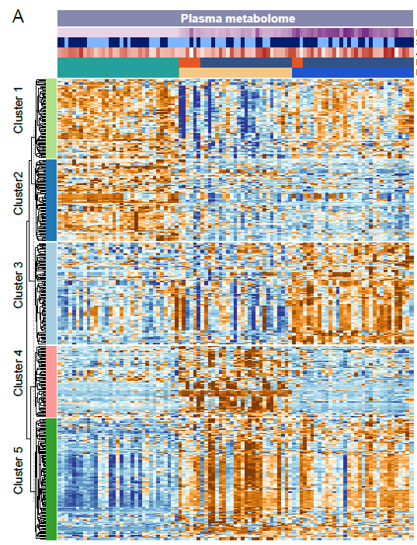

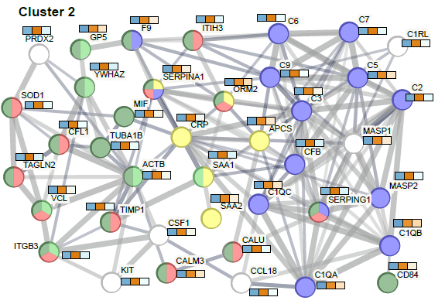
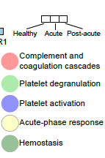
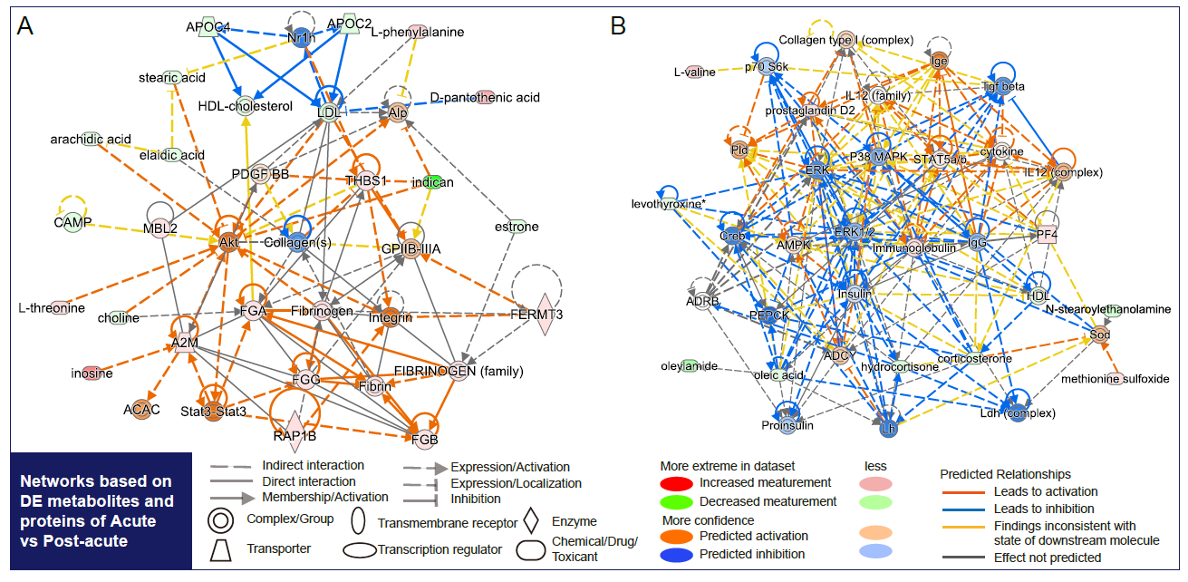
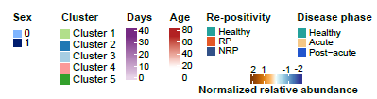
Plasma Omics display platelet relevant changes

Slide 20
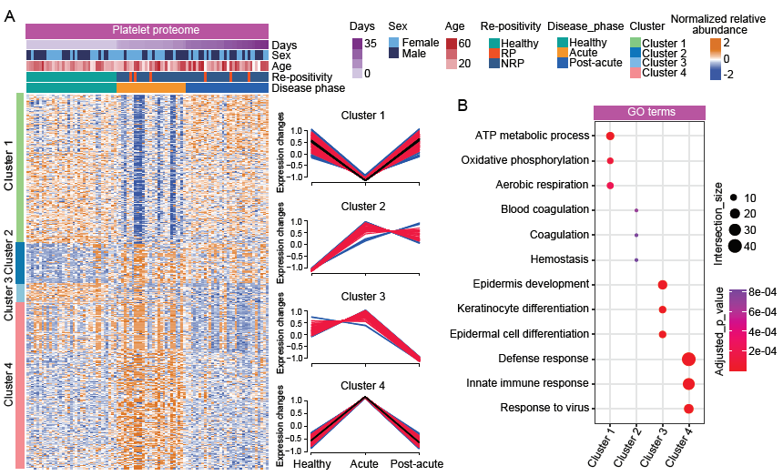
Platelets from Acute Omicron patients display strong immune signatures

Slide 21
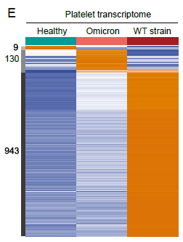
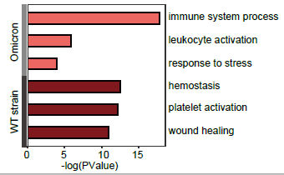

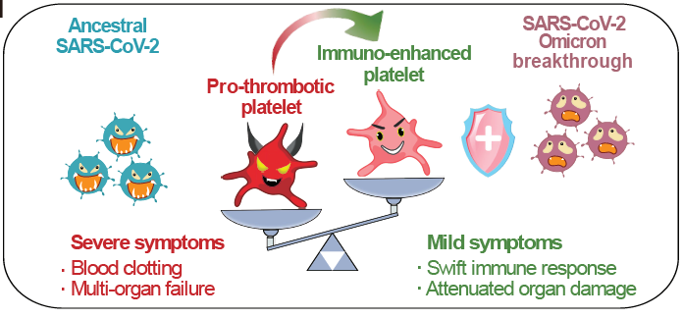
Platelets switch from “Villain” to “Hero”
“Villain” to “Hero”

Slide 22
Summary
Globally attenuated host responses in Omicron vs WT Strain
Plasma Omics display prominent platelet related changes
Platelets display reduction of canonical hemeostasis character but obtained enhanced immune features
Notes:
This “re-positivity” is a special clinical phenomenon involving the recurrence of detectable viral RNA that is not caused by reinfection
re-positive patients can have active viral replication, possibly resulting in active viral shedding

Slide 23
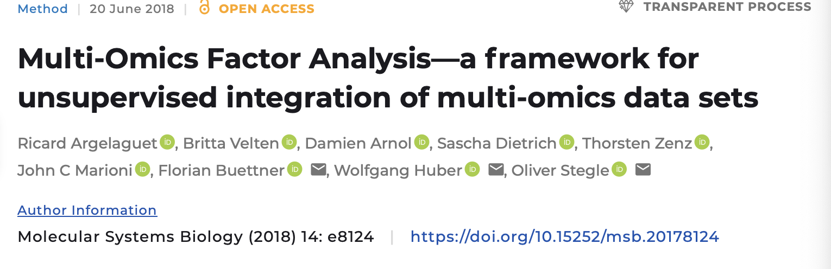
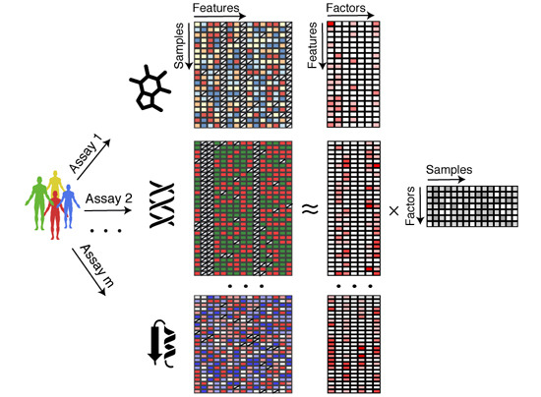
Multi-Omics factor analysis for upsupervised integration
Notes:
This “re-positivity” is a special clinical phenomenon involving the recurrence of detectable viral RNA that is not caused by reinfection
re-positive patients can have active viral replication, possibly resulting in active viral shedding

Slide 24

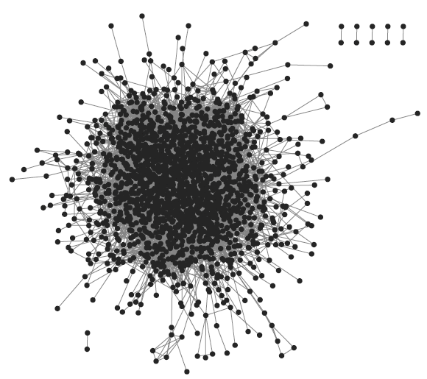
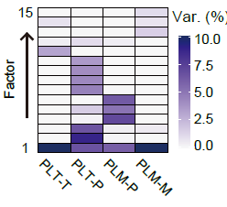
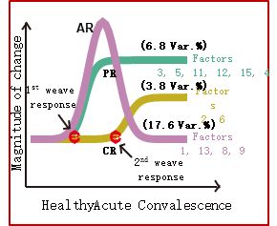
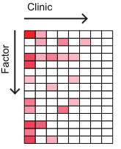
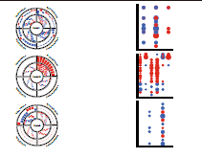
无偏因子分析整合多组学数据
应用多组学整合分析从血液生态的维度解析系统性疾病
无偏多组学整合因子分析方法：
性别
诊断
年龄
错综复杂的变化
降维成因子
用药史
1
多维度组学
2
3
基础病
临床
干扰因素
临床
表型组
多组学数据
基因组
蛋白组
转录组
因子与临床相关性
动态演化图谱
免疫组
代谢组
4
5
关键分子和通量解析
6
Clinical factors
干扰因素与关键因子
临床大队列研究的多组学整合分析方法

Slide 25
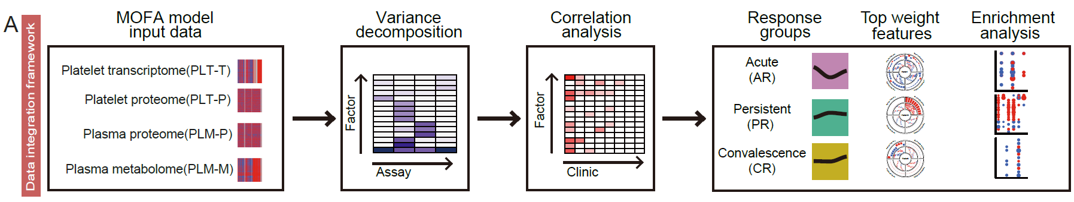
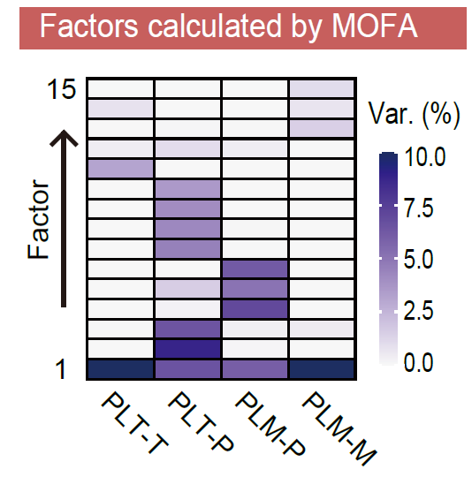
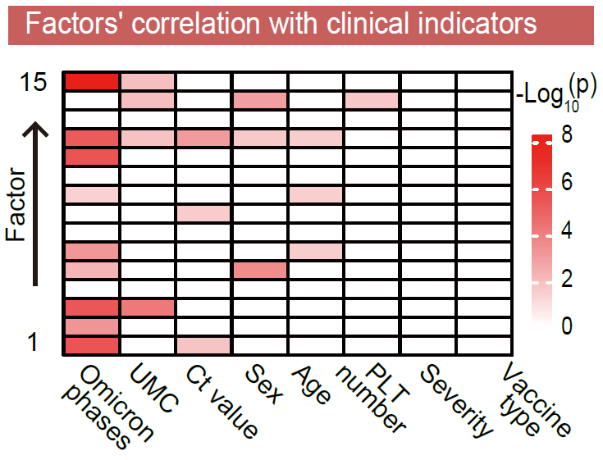
Multi-Omics Factor Analysis （MOFA） for unbiased data integration

Slide 26
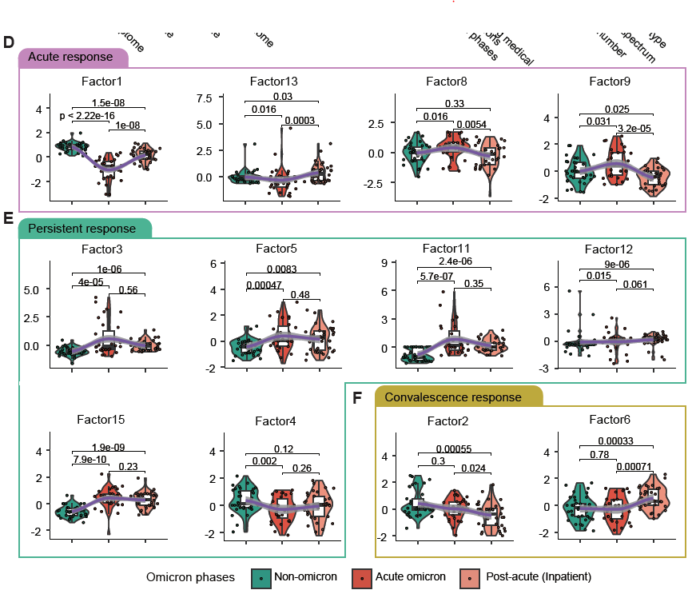
MOFA Defines Three Groups of Host Responses

Slide 27
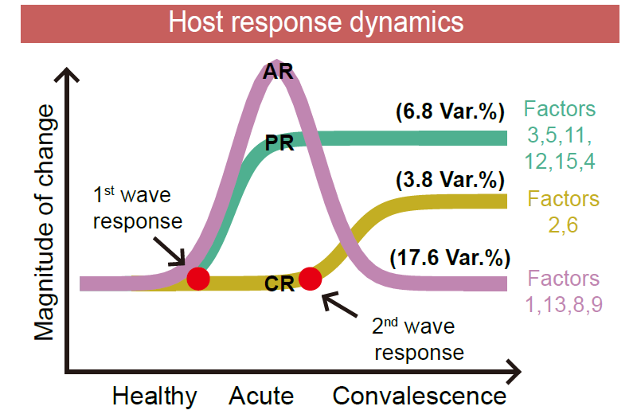
MOFA Defines Three Groups of Host Responses
Define the Time-resolved Omicron Host Responses:

Slide 28
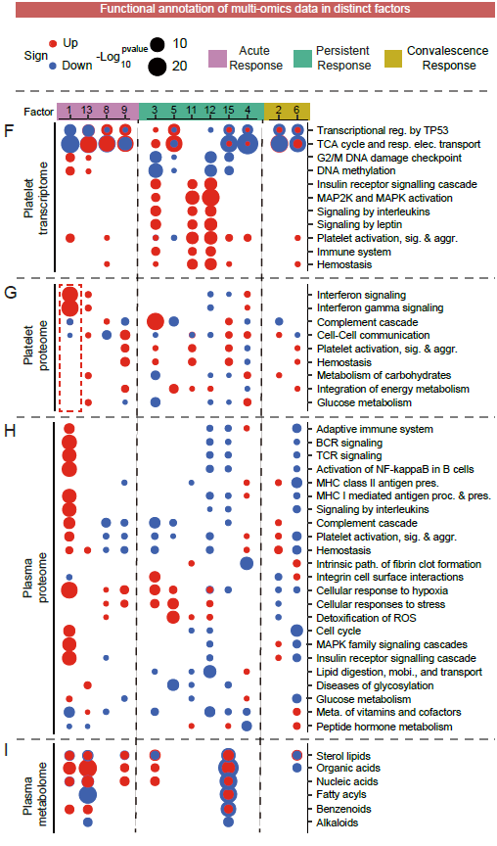
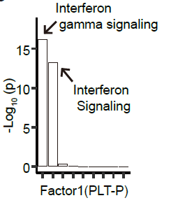
Dominant Interferon medicated antiviral responses in Omicron Platelet

Slide 29
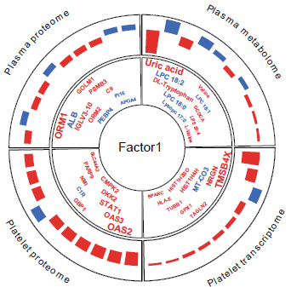
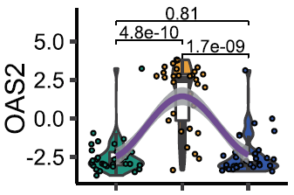
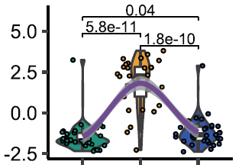
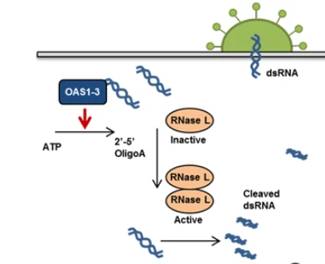
Top weighted platelet proteins are key antiviral factors downstream of interferon
OAS2
OAS3
(Oligoadenylate synthase) OAS family proteins are key antiviral factors downstream of interferon.
Choi UY et al. EEM. 2015
Notes:
Following virus infection of a host cell, viral dsRNA stimulates OAS1, OAS2 and OAS3 and leads to the synthesis of 2′-5′ oligoA and RNase L activation

Slide 30
Summary
Globally attenuated host responses in Omicron vs WT Strain
Platelet Omics display prominent platelet related changes
Platelets display reduction of canonical hemeostasis character but obtained enhanced immune features
Unbiased multi-omics integration reveals the landscape of host response dynamics
Platelet shows strong interferon mediated antiviral signatures
Notes:
This “re-positivity” is a special clinical phenomenon involving the recurrence of detectable viral RNA that is not caused by reinfection
re-positive patients can have active viral replication, possibly resulting in active viral shedding

Slide 31

Single cell
Bulk

Slide 32


Platelets preferentially form aggregates with immune cells

Slide 33


Platelets preferentially form aggregates with immune cells

Slide 34

Platelets preferentially form aggregates with immune cells

Slide 35
Summary
Globally attenuated host responses in Omicron vs WT Strain
Platelet Omics display prominent platelet related changes
Platelets display reduction of canonical hemeostasis character but obtained enhanced immune features
Unbiased multi-omics integration reveals the landscape of host response dynamics
Platelet shows strong interferon mediated antiviral signatures
Platelet preferentially form aggregates with leukocytes and modulate T cell activity
Notes:
This “re-positivity” is a special clinical phenomenon involving the recurrence of detectable viral RNA that is not caused by reinfection
re-positive patients can have active viral replication, possibly resulting in active viral shedding

Slide 36

Re-positive vs Non-re-positive patients

Slide 37



Re-positive vs Non-re-positive patients

Slide 38


Machine Learning to Predict Re-positivity

Slide 39
Scientific Question to address
1. Can we identify novel interactions and properties in the blood ecosystem in SARS-CoV2 Omicron infected patients?
components + interaction = property
3. Can we reveal mechanism underlying ‘re-positivity for viral RNA’ and provide strategies to screen and treat re-positivity?
Notes:
This “re-positivity” is a special clinical phenomenon involving the recurrence of detectable viral RNA that is not caused by reinfection
re-positive patients can have active viral replication, possibly resulting in active viral shedding

Slide 40

Summary
Blood Ecosystem
‘Blood Ecosystem’ concept first reported in high profile journal
Selected as Cover story

Slide 41








Acknowledgements
课题组成员：
Tao Cheng
Guo
Tiannan
Jiaxi Zhou
Ping Zhu
Wang
Ximo
Shen
Zhongyang
天津海河实验室揭榜挂帅项目
医科院创新工程
天津市杰出青年基金
国家高层次留学回国人才资助项目
国自然面上
天津海河科技领军人才项目
刘翠翠 谢小韦 牛明明 王瑛睿 程雪莲 张标

Slide 42



细胞生态海河实验室

Slide 43
前沿技术中心

Slide 44














科研团队
已建立一支年轻充满活力和竞争力的团队：
课题组教师团队：
课题组技术工程师 (2名）：
以第一作者发表Cell Metabolism, Cancer Letters 等高水平研究论文6篇
主持国家自然科学基金面上和青年等国家和省部级项目3项
获第十届中国免疫学会学术奖-青年学者奖
生信工程师
质谱工程师
申龙
副研究员
博士学生(3名）和 硕士学生（3名）：
美国St Jude Children’s Research Hospital博士后
以第一作者（含共同）发表Immunity, Analytical Chemistry等高水平论文7篇
主持天津市海河揭榜挂帅子项目和协和校基项目
与王建祥教授以及天医大联合培养博士学生(2名）和硕士学生（2名）：
牛明明
助理研究员
团队现招募博士后、助研和副研！！！
Tel:13388008038
Email: wanghong@ihcams.ac.cn
Notes:
去掉多个人的PPT， 展望

Slide 45
敬请批评指正
谢谢

